Slide 1
Personal assistants in care
A hidden workforce?
Zoe Porter, GMHSCP
Person and Community Centred Approaches programme
Zoe.Porter1@nhs.net/ gmhscp.pcca@nhs.net
Chris Hamnett, Embrace Wigan and Leigh
c.hamnett@embracewiganandleigh.org.uk

Slide 2
Housekeeping
Greater Manchester Virtual Workforce Summit
GM Workforce summit 2020
  Keep your camera on​ where possible.
  And your mic on mute to avoid feedback.​
  Raise your hand to speak​ when you want to contribute.
  Use the chat function to share thoughts/feedback
  Answer the door/grab a drink if you need to
#GMwfsummit2020
#Doingthingsdifferentlyforourworkforce

Slide 3
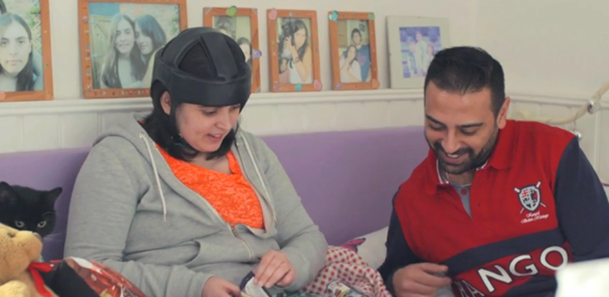
Personal Assistants in Care
This session covers:
Background and rationale for work on marketing and recruitment of Personal Assistants (PAs) for people who have health or social care budgets – Zoe
Experience - being a PA, an individual employer, a support organisation - Chris
How could we attract, and support PAs better? – conversation
But before that… let’s say hello!

Slide 4
Background and Rationale
A PA is someone employed directly by a health or social care direct payment recipient to support them with various aspects of their daily life, to help them live as independently as possible.
Problem
Opportunity
Opportunity
Problem
More than half direct payment employers report that recruitment is a problem* – and there are estimated to be over 10,000 PA roles needed across GM
Awareness and visibility of the PA role is low, so people do not consider it as a career option, unless they have some existing personal connection, or happen to come across an advert
There is a new market emerging of people who could make great PAs, as other sectors take the brunt of the economic damage caused by the pandemic
We can work together to make the PA role more visible, and make it easier for prospective candidates to access vacancies
*2017 Skills for Care survey

Slide 5
marketing resources
A series of marketing resources e.g. leaflets and poster templates, social media templates
Can all be personalised by individual localities to be used locally
Alongside a whole set of other useful comms materials – stories, blogs, press releases, stock photos etc – all freely available to GM organisations
Developed across GM with a group of stakeholders including localities, PAs, direct payment employers etc.

Slide 6
A4 poster
Different versions for variety, and targeting different demographics

Slide 7
2-sided a5 FLYER

Slide 8

Facebook
We think Facebook will be the main way to reach potential PAs.

Slide 9
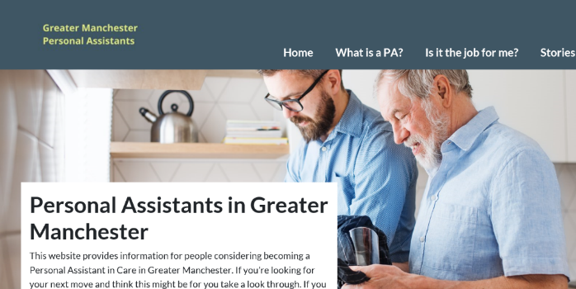
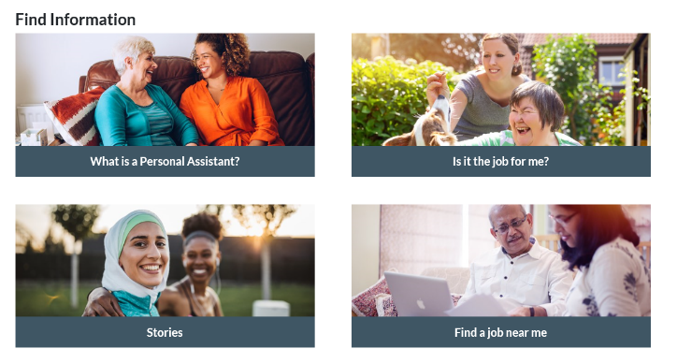
The website:
FOR FURTHER information
Gives more information about being a PA - populated with info from the excellent Skills for Care resources, plus locally sourced real-life stories from PAs and their employers to bring the role alive
Links to the best way to find vacancies for each locality – this might either be a council DP team, PA Web, or local brokerage/ VCSE organisation who lead in this area.
Available now at greatermanchesterPA.org.uk
All the marketing resources also downloadable from a non-public page at greatermanchesterPA.org.uk/resources

Slide 10

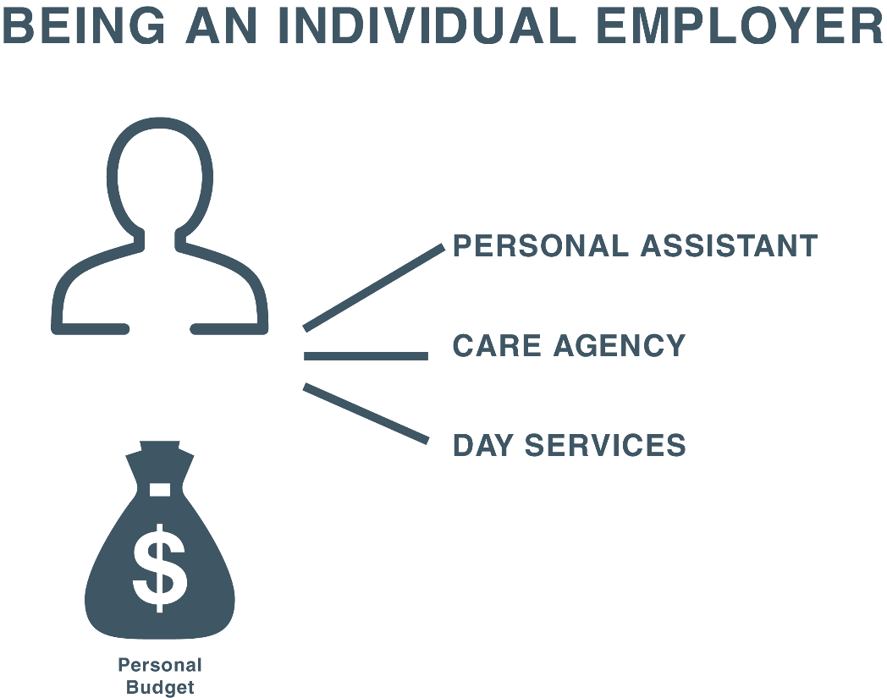

Slide 11


Slide 12
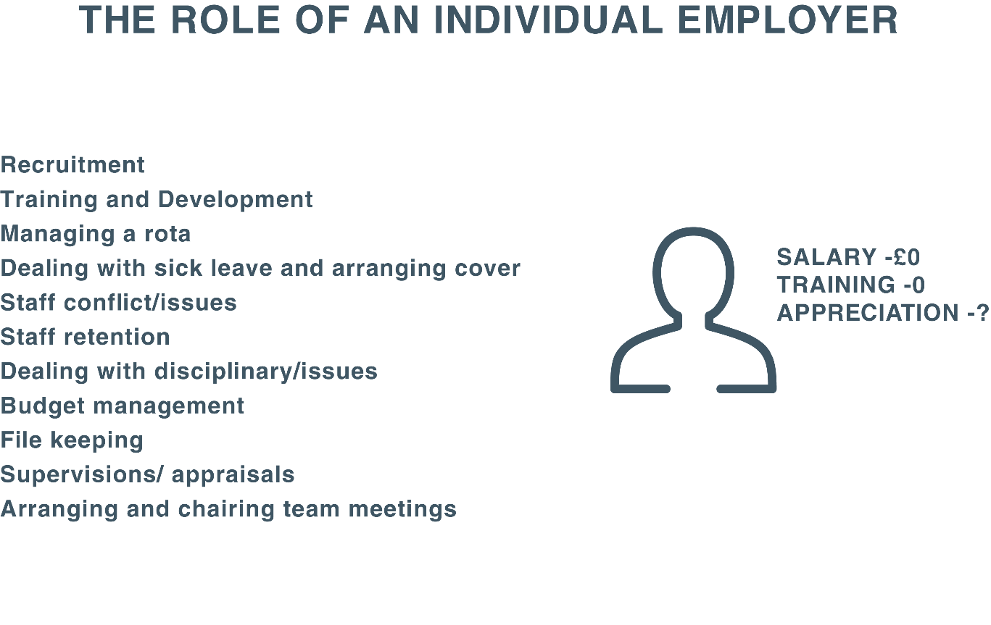

Slide 13
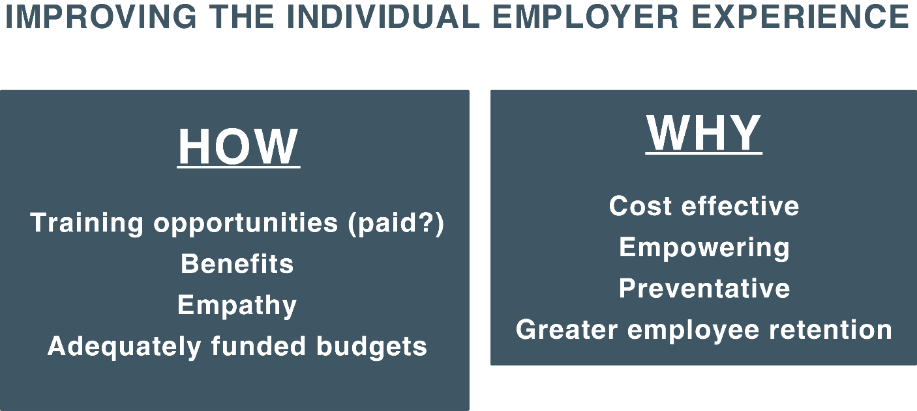

Slide 14


Slide 15
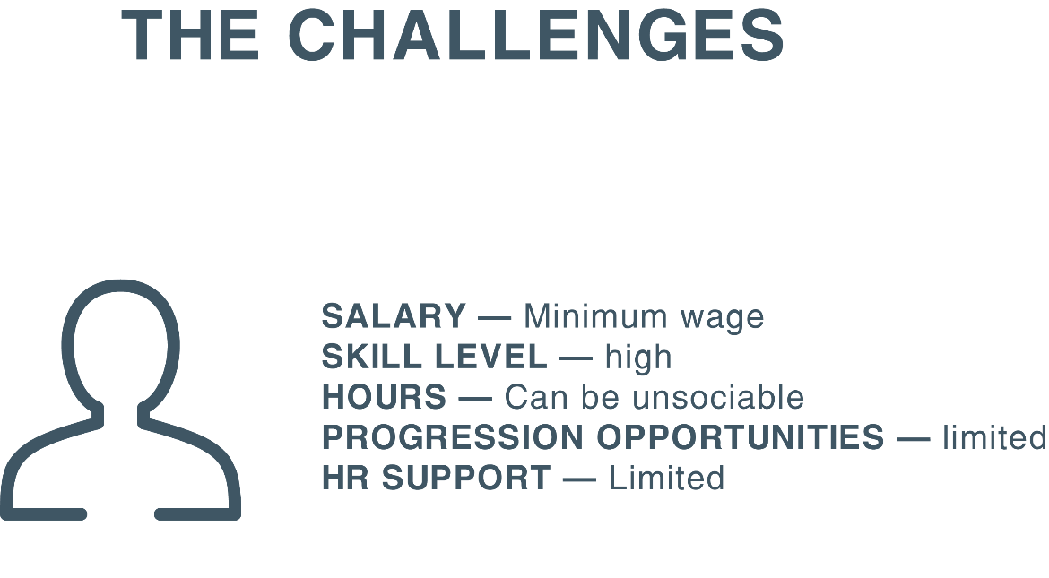

Slide 16
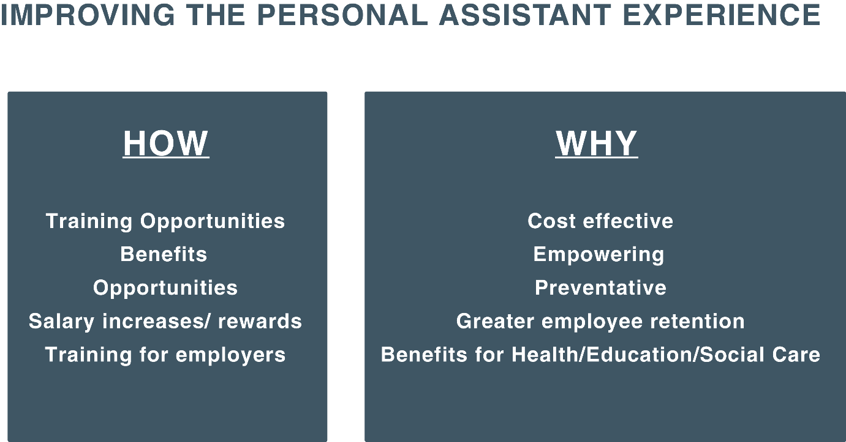

Slide 17


Slide 18



Slide 19

gmhscp.pcca@nhs.net

