Slide 1
NORTH WEST Bring Back Staff Programme:
Summit November 2020
Yvonne Rogers, NW Regional BBS Lead – yrogers@nhs.net
Christopher Buckley, NW BBS Programme lead – Christopher.buckley3@nhs.net

Slide 2
NORTH WEST Bring Back Staff: Background
Phase 1
In response to the Covid pandemic the Bringing Back Staff campaign was launched nationally in mid-March 2020 to invite those who have been out of practice within the last 3 years (WAVE 1) and later to those within the last 5 years (WAVE 2) to potentially return to some form of work spanning the following professional groups:
Nurse
Medics,
Healthcare Scientists (HCS);
Pharmacists –
Department for Work and Pensions (DWP)
Healthcare Support Workers (HCSW).
Nationally, over 47,000 retired clinical staff offered to return to work.
11,500 to non face-to-face services and of these we already have 1,600 on the NHS 111 service.
During this early phase regional BBS hubs were established to support completion of employment screening process to assist NHS organisations to mitigate potential workforce pressures and gaps.
Approximately 4,000 returners within the North west, have been processed with almost 1,500 being deployed across Medics, Nursing, Allied Health Professionals, Pharmacy and Health Care Science.

Slide 3
NORTH WEST Bring Back Staff: NW BBS Transition to Phase 2
The region’s (summer) support team for Bringing Back Staff to the North West closed 31st August 2020 and prompted the start of Phase 2.
The NW People Cell proposed a number of options to take the work programme forward. It was agreed through this process that the Greater Manchester Health and Social Care Partnership workforce team would take the work forward on behalf of the NW regional system.
The option for a ‘system led regional approach’ was accepted as the appropriate model for the North West to implement a more sustainable platform in support of the region’s workforce requirements moving forwards in advance of a potential second peak and in addition to forth coming winter pressures, flu outbreak and as part of the COVID-19 recovery process across the North West.

Slide 4
NORTH WEST Bring Back Staff: NW BBS Phase 2 and Phase 3
Phase 2
During August/September the work transitioned to a new team to represent the NW footprint across the 3 Sustainability and Transformation Partnerships of Greater Manchester, Cheshire and Mersey, Lancashire and South Cumbria.
Funding for the programme has been allocated through NHSE/I to March 2021 and small team is now being created to manage the work programme.
Immediate focus has been to cleanse the current workforce data and secondly to understand the NW demand for potential returners to support current and future workforce pressures.
Phase 3
Consideration will then follow for the development of a NW Reservist model yet to be determined

Slide 5
NORTH WEST Bring Back Staff: Programme Priorities and campaigns
Phase 2 priorities
Immediate focus has been to cleanse the current workforce data and secondly to understand the NW demand for potential returners to support current and future workforce pressures.
Managing local and national workforce requests.
Ambition to capitalise on the interest from BBS returners and deploy as many candidates as possible into permanent ‘employment’. Target figure set to 40% of the total number of NW BBS candidates by March 2021
Phase 3 priorities
Consideration will then follow for the development of a NW Reservist model yet to be determined
The team have engaged in a number of ‘campaigns’ which will allow the team to validate the current NW ‘BBS stock level’ gaining a clearer picture on BBS candidate’s commitment, skill mix, registration, potential for longer term employment and provide a more informative ‘match making service’ to regional and national requests.
Current campaigns being undertaken
Nurse / Medics ‘Ready to Deploy’ campaign that has allowed the team to validate a current portion of the NW BBS register which has informed local (regional) and national workforce requests.
Nurse Returners campaign for those currently categorised as ‘Employed’ on the BBS register extending to those within the register who are not currently deployed into employment and categorised as ‘Ready to Deploy’.
All professions campaign which will identify the capacity within the NW BBS register of those who have not yet been communicated with, i.e, Healthcare Scientists; Allied Health Professionals; Pharmacists; Denistry.
Medics Campaign

Slide 6
Bringing Back Staff:
NW BBS Plan – Outline summary
Purpose
To support demand in the system against those on the BBS register
To understand current demand in the system which will include; existing clinical vacancy levels; covering gaps created by sickness/ absences; workforce pressure in response to Phase 3 capacity and demand planning; supporting Mass Vaccination programmes (specifically Covid and Flu).
Ambition
Aspiration (TBC) to have 40% of returners employed within the system by March 2021
Remaining 60% (TBC) flexible to respond to surge capacity requirements
Consider the viability of a Reservist model to support developing workforce requirements for the future
Plan
Stable database: Cleanse and Validated
Communication to Systems; NW BBS pool; Potential Future candidates
NW Demand and Capacity review
Recruitment to BBS team and to BBS candidates pool
Build a sustainable model for the North West
Maximise the employment rate
Build a sustainable model
PRIMARY DRIVERS
Improve Returner Experience

Slide 7
NORTH WEST Bring Back Staff: National & Local priorities
Notwithstanding emerging NW priorities, the NW BBS team are also being asked to align the work programme with national initiatives and to encourage those on the Register to work in these nationally agreed areas:
Mass vaccination programmes for Covid and flu
Continuing healthcare – to support deferred assessments
Blood and plasma harvesting
Nursing recruitment
Social Care
The team and steering group recognise the pressures in delivering this alongside local requirements particularly as there may be need for the current workforce to be deployed into some of these areas given the size and scale of these national priorities.
The Steering group will help focus and support the NW strategy to best accommodate local and national priorities. It is suggested that the initial focus should be on supporting the Mass Vaccination programme and appropriate local requests.
It will be important to assess requirements versus the need to deliver acute care particularly if there is a view that existing staff will be needed to deliver the vaccination programmes at local level.

Slide 8
NORTH WEST Bring Back Staff:
Governance Arrangements
A proposed governance to support the transition from Phase 2 to the new Phase 3 programme and ‘post BBS strategy’ would include the following structures:
Sets National requirements and processes
NHSE/I National Team
Oversight of Regional workforce and risks including BBS and Reservist programme.
Decision making group with delegated authority
North West People Team
C&M Peoples Board
GM Peoples Board
LSC Peoples Board
Oversight and lead the future design of a regional STP led programme for BBS / Reservist model
NW Regional Steering Group
Professional Advice forum
NW Professional Advisory Group
Strategic and Operational delivery of the BBS programme
NW Regional BBS/Reservist
Programme Team

Slide 9
NORTH WEST Bring Back Staff: BBS candidates and principles
Initially the NW BBS register identified approximately 1823 potential candidates to support NW services which is now more closer to 1700, following withdrawals either because an individual has gained employment or is no longer able to support the response.
It should be noted that the majority of people have expressed an interest in providing support during the pandemic not necessarily working fulltime at the ‘coal face’.
Feedback from some candidates has been that they need more focussed support whilst undertaking duties – some have withdrawn because they have not had the level of support they needed especially as they have been away from the service for a while.
We are reviewing the information to help us better match the individuals skills and competencies with the opportunities within organisations.
It is important to manage expectations of both employers and those on the Register.
Nationally there is a ‘push’ to transition the majority of those on the Register into permanent employment but anecdotally we are aware that many would prefer a more flexibly working arrangement which lends itself to the future Reservist programme.

Slide 10
NORTH WEST Bring Back Staff: BBS Definitions
HEADING | DEFINITION
Actively withdrawn 1 - keep informed | The Returner has withdrawn from phase 1 of the BBS process but would like to hear about future opportunities
Actively withdrawn 2 - no further contact | The Returner has withdrawn and is not interested in any future opportunities
Uncontactable | Following receipt of information from Capita, have been unable to contact Returner to progress to deployment
Unsuitable | The person is deemed to be unsuitable to return to the NHS
Ready to deploy | Returners ready for Deployment but not yet put forward or made available at individual Trust/Organisation level
Deployed | Returners ready for Deployment and made available at individual Trust/Organisation level
Employed | Returners Employed by an Individual Trust/Organisation on a permanent, fixed term or bank basis
Active | The sum of Actively withdrawn 1 - keep informed, Ready to deploy, Deployed and Employed
Other (please specify) | Out of area or duplicate

Slide 11
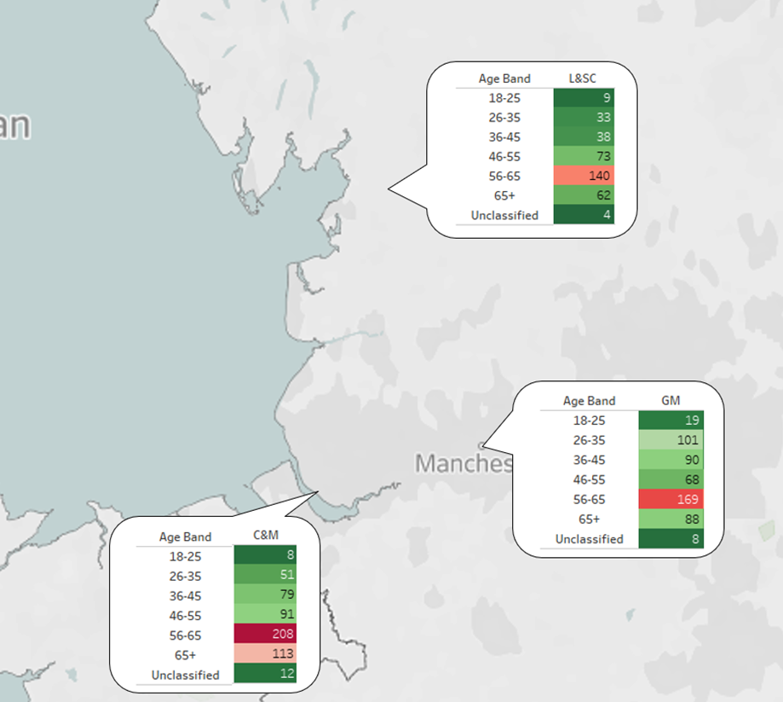
NORTH WEST Bring Back Staff: NW BBS Candidate Age profiles

Slide 12
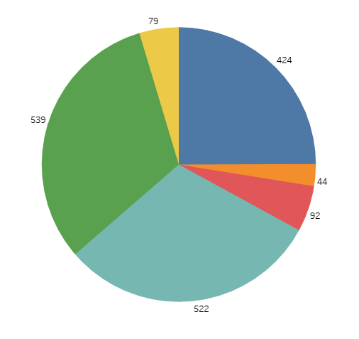
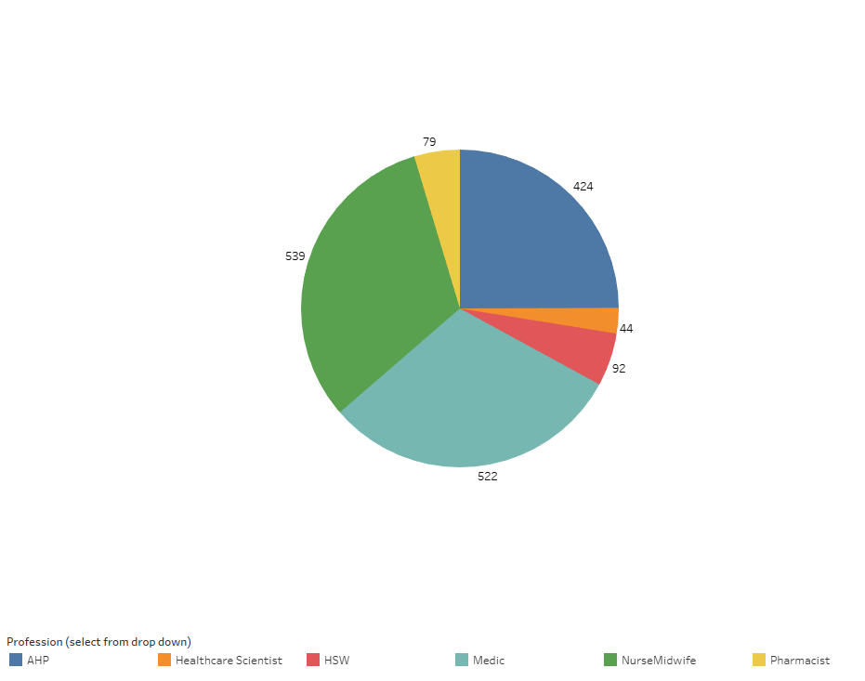
NORTH WEST Bring Back Staff: NW BBS Professions
Total number of returners split by profession (deployed, employed or ready to deploy)* Undergoing validation so numbers may be subject to change

Slide 13
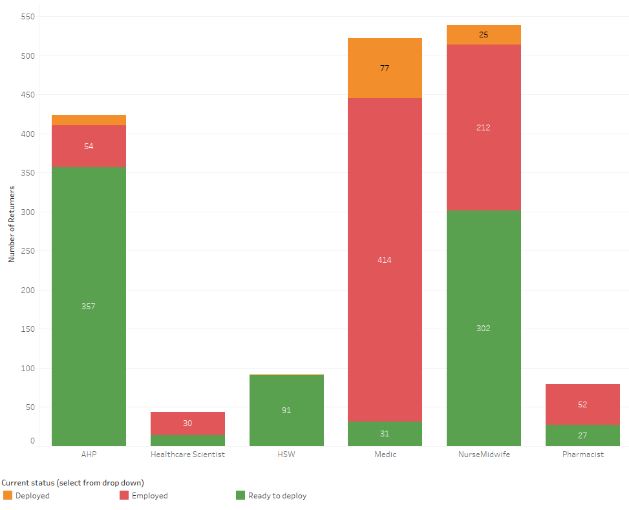
NORTH WEST Bring Back Staff: NW BBS Role profiles
Number of returners deployed, employed or ready to deploy split by profession:

Slide 14
NORTH WEST Bring Back Staff: Nurse/ Medics Campaign example
Nurse/Medics ‘Ready to Deploy’ campaign
Initiated in early September.
Provided rich master data validation.
The campaign is being used to support local requests and Nurse returners campaign with Andrea Boland.
Analysis
Identified that of the circa 395 contacted we received 212 responses (as of 02.10.20).
185 wish to remain on the NWBBS register of which 170 were nurses.
15 were Medics
Of the NON responses 158 were Nurses.
25 Withdraw - 4 Gaining Employment - 14 No reason - 7 Personal.
122 stated a working pattern: 30 Permanent - 63 Bank - 97 Flexible - 14 Covid Response.
Majority expressed support for Flu/Covid Vacs programme.
Profession Subset | Total Responses of 185 | Permanent Register identified | Temporary Register identified | Non Responses
TOTAL NURSE | 170 | 135 | 16 | 158
Adult Nurse | 103 | 79 | 11 | 96
Children's Nurse | 18 | 14 | 2 | 17
Learning Disabilities | 7 | 7 | 0 | 5
Mental Health | 24 | 19 | 2 | 22
Midwife | 11 | 9 | 1 | 12
Unknown at Present | 0 |  | 18 | 3
Blanks | 7 | 7

Slide 15
NORTH WEST Bring Back Staff: Nurse Returners Campaigns
Nurse Returners campaign
Working with Andrea Boland and Danielle Fullwood together with a small group of registered nurses to explore the opportunities with thin the 216 nurses on the current NW BBS register to improve employment.
Current Progress
Script management
Webform production
Master dataset validation and compatibility for data entry with the nursing team.
Profession | Summary |  |  |  |  | Permanant Register identified |  |  |  |  | Temporary Register identified
 | Total Wave1 + Wave2 | Ready to deploy | Employed | Withdrawn | Other | Total | Ready to Deploy | Employed | Withdrawn | Other | Total | Ready to Deploy | Employed | Withdrawn | Other
NURSE | 1265 | 328 | 216 | 652 | 69 | 757 | 275 | 181 | 248 | 53 | 93 | 33 | 29 | 22 | 9
Adult Nurse | 824 | 199 | 151 | 428 | 46 | 497 | 168 | 126 | 167
Children's Nurse | 123 | 35 | 22 | 58 | 8 | 77 | 28 | 18 | 25
Learning Disabilities | 38 | 12 | 7 | 16 | 3 | 22 | 11 | 3 | 6
Mental Health | 179 | 45 | 28 | 97 | 9 | 99 | 37 | 26 | 29
Midwife | 82 | 23 | 8 | 48 | 3 | 48 | 18 | 8 | 20
Unknown at Present | 8 | 3 | 0 | 5 | 0 | 3 | 2 | 0 | 1
Blanks | 11 | 11 | 0 | 0 | 0 | 11 | 11 | 0 | 0

Slide 16
NORTH WEST Bring Back Staff: NW BBS Request Process
Email request from provider organisations to COVID-19.nwdeployment@NHS.Net
The NW BBS Team process the request and identify the request with a Provider Response Form number.
Candidates are identified from the NW BBS Register as potentials and communicated with the opportunity: ‘Ready to deploy’
Candidates on the Register are contacted to determine their interest.
Candidates express their interest in the identified opportunities
A 1:1 with the requesting provider is set up with the NW BBS team to discuss potential candidates and next steps: ‘Deployed’
A meeting is set up between the organisation and the candidate to explore the opportunities.
the organisation will take responsibility for liaising with the: ‘Employed’
Those not selected for employment return to the NW BBS register and are ‘Ready to deploy’ for the next NW opportunity.

Slide 17
Thank you & Questions

