Slide 1
Virtual Workforce Information System (VWIS)
Information Pack

Slide 2
Contents
Contents
Context and Overview
VWIS Analytics
Data Requirements
Get Involved
Contact Info and Resources

Slide 3
Context and Overview
Context and Overview

Slide 4
Context and Overview
Context and Overview
Why do we need VWIS?
NHS Trusts
Primary Care
Social Care
Meaningful Cross-System Analytics
The Virtual Workforce Information System (VWIS) tool is a bespoke resource created for and by the Greater Manchester health and social care system, to facilitate Local Care Organisations understanding of the shape and composition of the integrated care workforce. The tool acts as an enabler of workforce planning through a bespoke suite of views hosted in Tableau.
Workforce information is routinely collected using different systems across the health and social care landscape. Organisational workforce reporting takes place in silo without a mechanism to amalgamate the intelligence and make it available to the wider system
The tool allows health and social care systems to:
View workforce metrics as interactive visualisations to understand the composition of the integrated workforce and establish a single version of the truth
Identify areas of concern through visualisation of aggregated data and trends
Compare demographics across organisations and neighbourhoods

Slide 5
VWIS Analytics – Workforce Composition
VWIS Analytics

Slide 6
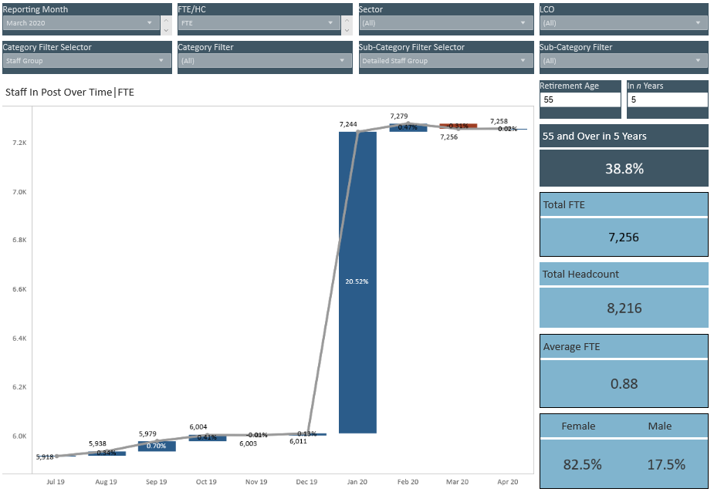
Workforce Composition
VWIS Analytics
Workforce Composition
Offering the ability to understand the shape, size and key features that make up your workforce, VWIS, is a single version of the truth, helping you get a better understanding of your whole-system locality workforce. VWIS can help you with:
Cross-system workforce planning such as developing Neighbourhood Teams
Retirement forecasting and succession planning
Identification of lower resilience areas where new or novel roles could be utilised
Customisable filtering
Retirement Modelling Tool
Headline Analytics
Whole system staff group analysis

Slide 7
VWIS Analytics – Workforce Characteristics
VWIS Analytics

Slide 8
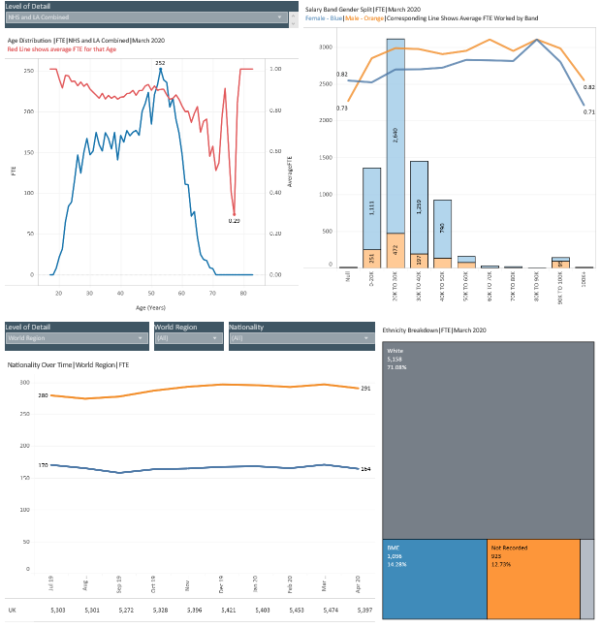
Workforce Characteristics
VWIS Analytics
Workforce Characteristics
Understanding the characteristics of the workforce within a locality is a powerful tool in ensuring we have a workforce reflective of the communities they serve. VWIS analyses data on:
Gender
Age
Nationality/Region of birth
BAME status
Ethnicity
Age distribution and average by FTE
Salary range by gender
Nationality or World Region by FTE
Ethnicity Breakdown

Slide 9
VWIS Analytics – Absence & Turnover
VWIS Analytics

Slide 10
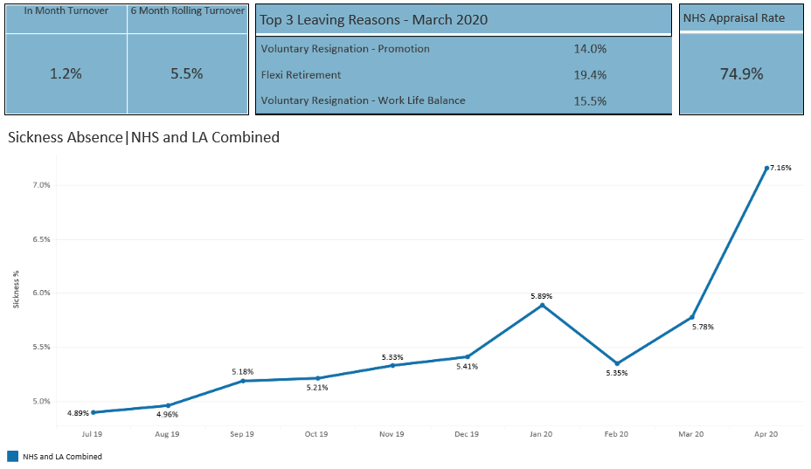
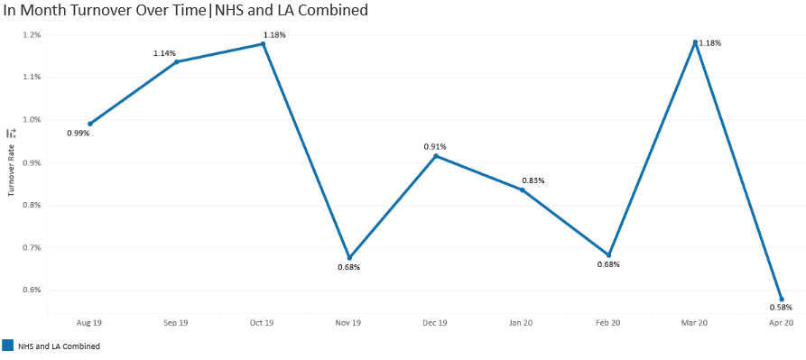
Absence & Turnover
VWIS Analytics
Absence and Turnover
Understanding absence data across a locality can assist with:
Identifying areas of high sickness/absence within specific staff groups or roles
Recognising trends or spikes in specific absence reasons
Developing locality wide schemes to tackle absence hotspots
Similarly, turnover data can be analysed to:
Recognise patterns in leaving reasons or destinations
Detect potential areas of low resilience due to high turnover rates
Sickness Absence % by month
In Month Turnover

Slide 11
VWIS – Data Requirements
Data Requirements

Slide 12
Data Requirements
Data Requirements
VWIS has been designed to utilise data which is already captured and readily available to health and care organisations which can be split into four broad categories as below.
Staff In Post
Staff Group
Finance Ledger
Actual Positions
Absences
Start/End Date
Category
Role
FTE
Structure
Pay Grade
Budgeted Positions
Professional Registration
Leavers
Date
Reason
Type
Reason
Destination

Slide 13
Getting VWIS in your area
Getting VWIS

Slide 14
Getting VWIS In your area
Getting VWIS
Establishing VWIS in your locality is straight-forward and can be achieved in as little as four weeks. The VWIS team have developed resources to assist in the process including readiness assessments and Information Governance documents.
Induction
Data Supply
Access
Provide contacts for Finance, Workforce and Information Governance
Governance Arrangement
Review and sign off on data sharing arrangements and submission schedules
Sessions held with data suppliers to assist with initial reporting
First data submission provided
Web tool training provided to identified parties in the locality
Monthly data feeds ensure tool is up to date
Completion of readiness assessment tool
1-2 weeks
2-4 weeks
1-2 weeks
Ongoing

Slide 15
Information Governance
Getting VWIS
Information Governance
We are aware that information governance arrangements can pose significant challenges to collaborative workforce planning and as such we have worked with three pilot areas to develop a set of resources to be utilised in localities to create appropriate governance.
Data Protection Impact Assessment
Created in partnership with Manchester University FT, Bolton FT, Tameside and Glossop Integrated Care FT and Manchester City Council to assess the risks and potential impacts to data subjects of data processing for VWIS.
Data Processing Agreement
Also created with Manchester University FT, Bolton FT, Tameside and Glossop Integrated Care FT and Manchester City Council to provide the legal framework under which data will be processed by the VWIS team.
Lays out the data that will be shared, processes to be used and the protections that are put in place to protect data subjects.
Agreed and signed by the above organisations as well as Manchester Health and Social Care CCG.

Slide 16
Benefits
Getting VWIS
Benefits
Virtual Workforce Information System
Defined and Proven Information Governance Procedures
Clear and Consistent Analysis Across Health and Care System
Enabling Collaborative Planning Across Sectors
Free Resource to Utilise in Whole-System Planning
Consistently captured data enables clear analysis of resources in a locality and the wider Greater Manchester system.
A Data Protection Impact Assessment and an Information Sharing Agreement have been created and utilised in pilot areas to facilitate safe and effective data processing which has been reviewed and signed by multiple Trusts and Manchester City Council.
VWIS is a free resource which is available to all health and care organisations to assist with various kinds of workforce analysis and planning.
The VWIS platform enables all contributors to work from the same, consistent baseline of information and contribute to effective workforce development.

Slide 17
Key Considerations
Getting VIWS
Key Considerations
When looking to establish VWIS in your locality there are some key items to consider which will enable smoother implementation:
How do you envisage VWIS being utilised in your area?
What benefits do you expect to realise from using VWIS?
Short term
Medium term
Long term
Who will champion VWIS within each of the partner organisations in your locality?
Who are your intended users of the platform and will the way they use/interact with it be different?

Slide 18
Contact Information and Resources
Contact Information and Resources

Slide 19
Contact Information and Resources
Contact Information and Resources
Alan Slack – Senior Workforce Information Analyst – Alan.Slack@NHS.net
Jon Lenney - Director of Workforce & OD, Manchester Local Care Organisation (VWIS SRO) – Jon.Lenney@NHS.net
VWIS Inbox – nhs.gm.vwis@nhs.net

Slide 20
Contact Information and Resources

Slide 21
Thank you

