Slide 1
Skills Intelligence What are the current and future skill needs for the Greater Manchester Public Sector?
HSCP Summit 2020

Slide 2
Housekeeping
Keep your camera on​ where possible.
And your mic on mute to avoid feedback.​
Raise your hand to speak​ when you want to contribute.
Use the chat function to share thoughts/feedback
Answer the door/grab a drink if you need to

Slide 3
Aims of this session
Background: Overview of the Skills for Growth Programme
What is the Skills Intelligence Team?
GM Priority Sectors
Public Sector Focus Areas
Your intelligence!
Next Steps

Slide 4
Creating an employment and skills system that works for everyone
Employers able to grow their business through finding the right talent
Individuals able to develop their careers with clear progression pathways
Providers with flexibility and responsiveness to both employer and learner needs
Greater Manchester Strategy
Local Industrial Strategy
GM Recovery Plan
Work and Skills Strategy
GM Skills for Growth
Our Work and Skills Strategy confirms our commitment to strengthening employer engagement and developing the work and skills infrastructure to meet the needs of the economy.
Skills underpin every facet of life in Greater Manchester - we need more highly skilled people to grow the economy and raise productivity.
All of GM’s skills and work programmes form part of a complex skills landscape contributing to the talent pipeline
Critical role for targeted skills investment to unlock and enable economic growth through a system built with employer skills requirements at the heart.
Current skills system does not deliver enough people with high quality, relevant skills and, at higher technical levels required by employers.
We need a flexible and responsive skills and employment system which puts the needs of learners and employers at the heart of all that we do.
The Skills for Growth programme will support business growth, delivering an integrated approach to employment and skills - supporting providers to better meet the needs of residents and employers through the creation of new partnerships and innovative methods of delivery.
We want to demonstrate the importance of businesses engaged in the development and delivery of skills to ensure they meet their needs.

Slide 5
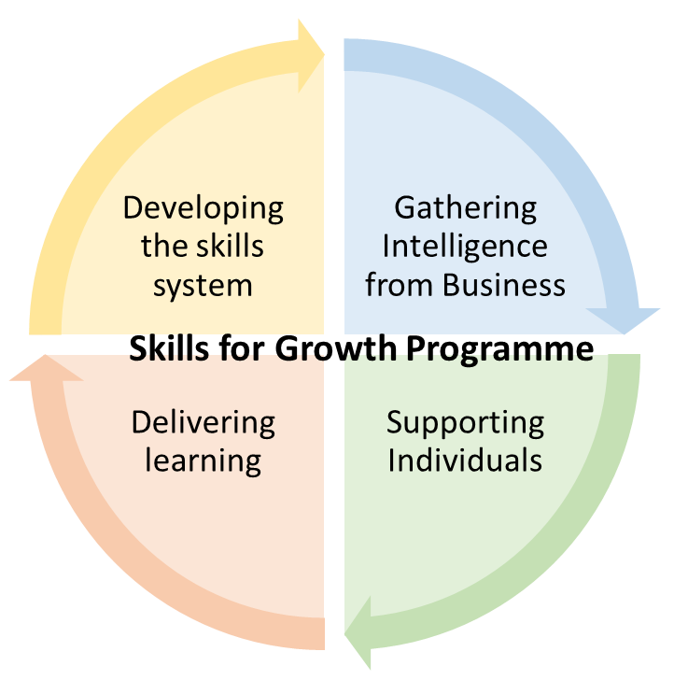
A way to bring this together: ESF Skills for Growth
£42m ESF, 3 year Programme.
Purposefully iterative
Designed to build a truly collaborative programme using real time intelligence.
SME Support now awarded, Oct go live.
Shapes skills delivery and responds to skills needs that emerge throughout.
Will commence commissioning late 2020, using GMCA’s new FPS and early intelligence.
Test and learn approach.
GMCA Skills Intelligence
Gathering
Developing
SME Business Support
c.£7m
Gathering
Supporting
Delivering
Innovation
Commissioning Skills Delivery
c.£30m
Developing
Supporting
Delivering
Individual and Business Growth
Filling the gaps to create occupational progression pathways.
Informing
Delivery

Slide 6
Skills Intelligence
The vision is to gather sector specific (and where required subsector specific) intelligence which communicates specific opportunities to address gaps in progression pathways and routes to priority occupations across frontier and foundation sectors set out in the Local Industrial Strategy
This intelligence will be used to increase talent pipelines for priority occupations by aligning skills programmes with employers needs and promoting a more responsive and collaborative approach to developing priority skills pathways

Slide 7
Pulling together intelligence from a large variety of employers and organisations working with employers
Employers and existing employer networks
Internal colleagues at GMCA:
Across the skills and employment portfolio
Local authorities
Research team
Local Industrial strategy team
Environment team
Housing team
Digital team
External organisations working with employers:
MIDAS
Growth Company
Made Smarter
Greater Manchester Chamber of Commerce
Sector specific societies and membership organisations (regional and national)
And more …..
Skills providers of all types and levels
This intelligence will add value through …
Providing a better understanding of progression pathways to priority jobs as well as true gaps in talent development across the GM economy.
Creating a more aligned and responsive talent and skills offer for residents and employers.
Supporting employers and other skills facilitating organisations to work collaboratively to make a bigger impact. Through both shared messages and focused engagement with the skills system.
Allow competency, talent and skills matching between sectors to support residents wanting to reskill and upskill as a result of COVID.

Slide 8
What are we doing that’s different?
1. Intelligence collection
2. Intelligence dissemination
Industry Skills intelligence report for wide variety of stakeholders.
Translation of intelligence for different stakeholder groups through various activity including knowledge sharing events.
Key groups:
Young people and their influencers
Career switchers and job seekers
Employers
Skills providers
3. Intelligence implementation
Aligning our £100 million of devolved skills provision to meet employer need including Skills for Growth Commissioning.
Using intelligence to support non- commissioned mobilisation to create a more aligned GM skills system.

Slide 9
What does the data tell us about the labour market currently: The picture in GMCA
Powered by MyInsights
Moderate Growth
Science & Research
Legal
Declining / Slow Growth Sectors
High Growth sectors
Finance and Insurance
Hospitality
Information Technology
Retail
Manufacturing
Logistics
Teaching
Admin
Construction
Marketing & Advertising
HR
Health & Social Work
Engineering
Arts & Entertainment
Creative & Design

Slide 10
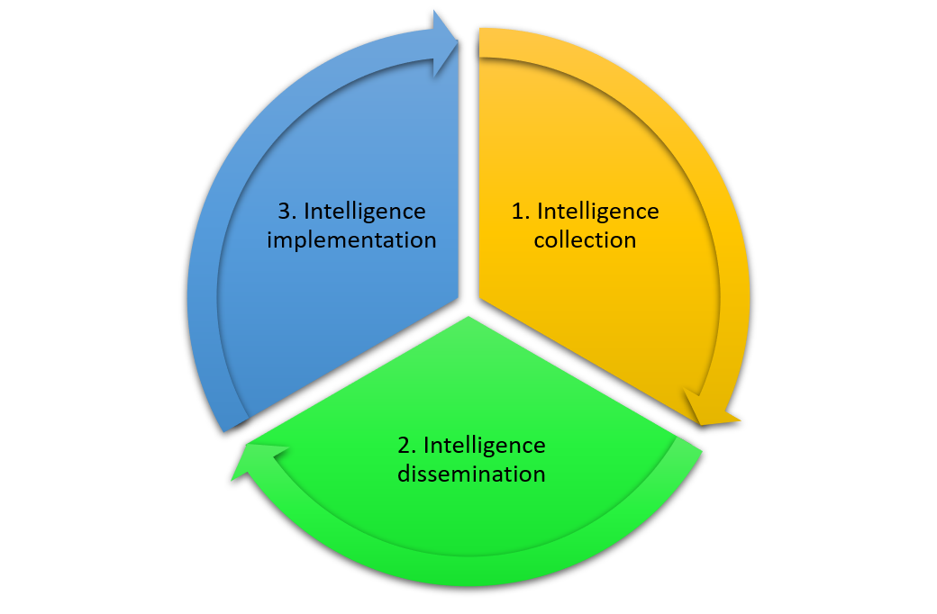
LIS Frontier and Foundation Sectors
Current focus from the Skills Intelligence Team will be on sectors identified within the Local Industrial Strategy. We will follow a similar process with each.
Frontier Sectors: Digital, Creative and Media
Advanced Materials and Manufacturing
Clean Growth and Carbon
Health Innovation
Foundation Sectors: Construction, Social Care, Retail and Hospitality

Slide 11
Public Sector Skills intelligence
The Greater Manchester Public Sector is a huge employer with a massive variety of roles.
We decided to break this down into more manageable chunks and focus on the key sub-sectors.
I have spoken and presented to various groups, as well as looking at some of our quantitative data and identified the first 4 priorities.

Slide 12
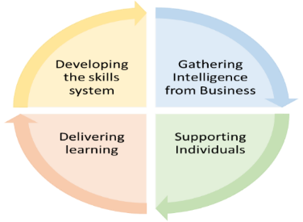
Industry Skills Intelligence – Public Sector
BENEFITS FROM APPROACH
TIMELINE AND PUBLIC SECTOR ACTION PLAN
Increased productivity through access to a talented, diverse workforce in GM
Confidence in finding training for a workforce which meets Public Sector needs
Increased ability to influence skills and talent provision in GM
Clear career progression pathways and entry level opportunities
Opportunities to upskill and to remove barriers within key sectors.
Increased ability to employer talent needs including creating more flexible provision which targets and supports different group of learners and increased knowledge of wrap around support for learners offering a high quality experience
Increased access and understanding of job opportunities in different sectors including opportunities in priority sectors
Increased residents securing and remaining in quality employment.
Identify the correct stakeholders who can provide accurate intelligence
Highlight existing good practice across GM that can be replicated more widely
Determine skill gaps, shortages and blockages and assess the necessary training provision
Process to prioritise sub sectors of the Public Sector
Over next few weeks, host workshops, and form sub groups of key individuals
Assess short term impacts of Covid-19 and longer term opportunities / threats.
CURRENT NETWORKS AND GROUPS
Public Sector Apprenticeship Network
Education Transformation Alliance
Approved Apprenticeship Provider Network
Primary Care Networks
HSCP Locality Groups / CCGs
HSCP Workforce Collaborative
AHP ‘New Ways of Working’
‘The GMCA Skills Intelligence team will work across the Public Sector to find out where the real occupational gaps are and will be able to recommend and support provision that can help to fill these gaps.’

Slide 13
GM PUBLIC SECTOR KEY SUB-SECTORS
HEALTH AND SOCIAL CARE
EARLY YEARS EDUCATION
CYBER SECURITY
FINANCIAL SERVICES

Slide 14
‘Care Worker role’
‘Public perception – currently mixed’
‘Foundational Skills are a barrier to apprenticeships
‘Low Pay is an issue’
‘Unsociable hours for certain positions limit the potential workforce’
‘Step into Care programme’
‘Need for some resilience training’
‘Recruitment process it too long and over complicated’
‘Off the job learning for apprentices’
‘Retention is issue and there is high staff turnover’
‘Financial constraints’
‘Struggle to recruit’
‘Recruit based on values not academic background or experience’
‘Health and Wellbeing of staff’
‘Increase update of Level 5 Practitioner apprenticeships’
‘The Fed have good progression pathways’
‘Variation in pay across the localities means that employee’s move around’
‘Massive unpaid workforce that are under-appreciated’
‘More compassionate leadership / management needed
‘Could we target other workforces decimated by Covid e.g airline / hospitality’

Slide 15
Over to you….
Key roles within sector
Why is recruitment difficult?
Why is retention difficult?
What is the skills gap/need?
What can we do to help?

Slide 16
Next Steps
Autumn/Winter 2020
Finish collecting intelligence around Health and Social Care Sector
Produce Version 1 of report for sector in GM
Begin disseminating report across localities and network
Winter/Spring 2021
Award of first skills delivery contracts.
Skills delivery commences
Possible upscaling of models of good practice
Implementation of report recommendations
Spring/Summer 2021
Using intelligence; more skills delivery contracts to be commissioned (every month)
Develop and produce Version 2 including findings gained from first version
Identify other sub-sectors across Public Sector with a skills need

Slide 17
Philip.pennill@greatermanchester-ca.gov.uk
Any Questions?
Industry Skills Intelligence Lead
Nichola Wallworth
Industry Skills Intelligence Officer (Public Sector)
Phil Pennill
Industry Skills Intelligence Officer
Joe Crolla
Industry Skills intelligence Officer
Caron Tinto

