Slide 1

University of Bolton
Care Home Education Award
Workforce Summit 2020

Slide 2

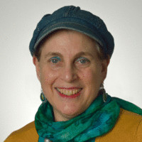
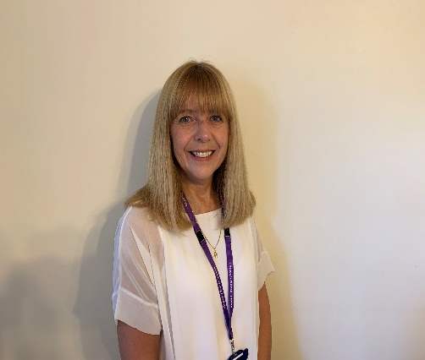

Introductions
Sue First
S.R.First@bolton.ac.uk
MSc FHEA PGCE SRCh Dipl Pod Med
Helen Lord
h.lord@bolton.ac.uk
RN MSc BSc (Hons) SPQDN HEF Queen's Nurse
Sean Freeman
s.freeman@bolton.ac.uk
RN DipHE BSc (Hons)
Programme Lead
Programme Design
Programme Manager / Tutor
University of Bolton Care Home Education Award

Slide 3

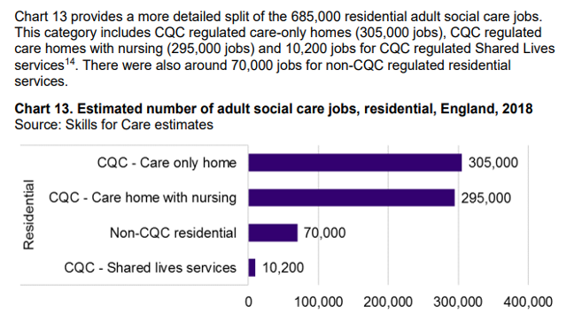
Care Homes Workforce Demographics
The social care workforce is different .​
As in health care, about 80 per cent of all jobs in adult social care are done by women; the proportion in direct care and support-providing jobs is higher, at 85-95 per cent (1).
​
In 2011 Most adult social care jobs (1.3 million, 74 per cent of the total) involve directly providing care. The rest comprise:147,000 managerial and supervisory jobs, 100,000 professional jobs (including social workers, nurses and occupational therapists) and 204,000 administrative, ancillary and other jobs (2).​
University of Bolton Care Home Education Award

Slide 4



Care Homes Workforce Demographics
In 2008 two-thirds (67 per cent) of people working as ‘care assistants and home carers’ claimed to be qualified to NVQ Level 2 or above, and 7 percent had no qualifications at all (2).​
The number of jobs in care homes with nursing increased between 2017 and 2018 (by 10,000 to around 295,000 jobs). This figure increased by 60,000 jobs between 2009 and 2018 (from 235,000 to 295,000 jobs). ​
1.Skills for Care (2010). Report. The State of the Adult Social Care Workforce in England​
2..Skills for Care (2011). Report. The Size and Structure of the Adult Social Care Sector and Workforce in England, 2011
Estimated number of adult social care jobs by induvial job roles in England, 2018.
Care Workers
840,000
Registered Managers
22,500
Registered Nurses
41,000
University of Bolton Care Home Education Award

Slide 5
Our People Plan
Key areas for focus highlighted in this plan include:
New place-based approaches to workforce planning
Utilisation of our health and care careers hub
Supported by innovative education programmes to attract more people into the health and care sector and focused work in primary care and social care to develop new roles and existing talent
The physical and psychological health and wellbeing of our entire workforce.
University of Bolton Care Home Education Award

Slide 6
Our People Plan
Develop targeted communications to attract a more diverse range of people into health and care careers. ​
Developing career pathways especially around the nursing group in primary care to upskill and offer the opportunity for progression; eg. admin to HCSW, to HCA to TNA to registered nurse, as well as encouraging apprenticeships to grow our own.
University of Bolton Care Home Education Award

Slide 7

Background
HEE funded project enhancing the capacity and capability of the Primary care work force. GP Forward 5 year review focus on Nursing and Care Homes​
Data collected from Care Home managers 2019​
Results Aligned to 7 core elements of Enhanced Health in Care Homes Framework model 2016
University of Bolton Care Home Education Award

Slide 8

Aspiring outcomes
Enhanced care provision​
Hospital admission avoidance​
Better management of Impact of Covid-19​
Increasing student placement capacity​
Career progression
University of Bolton Care Home Education Award

Slide 9
The Resident
If you were a resident in a care home, what would be the most important 3 things to ensure your comfort and wellbeing?

Slide 10
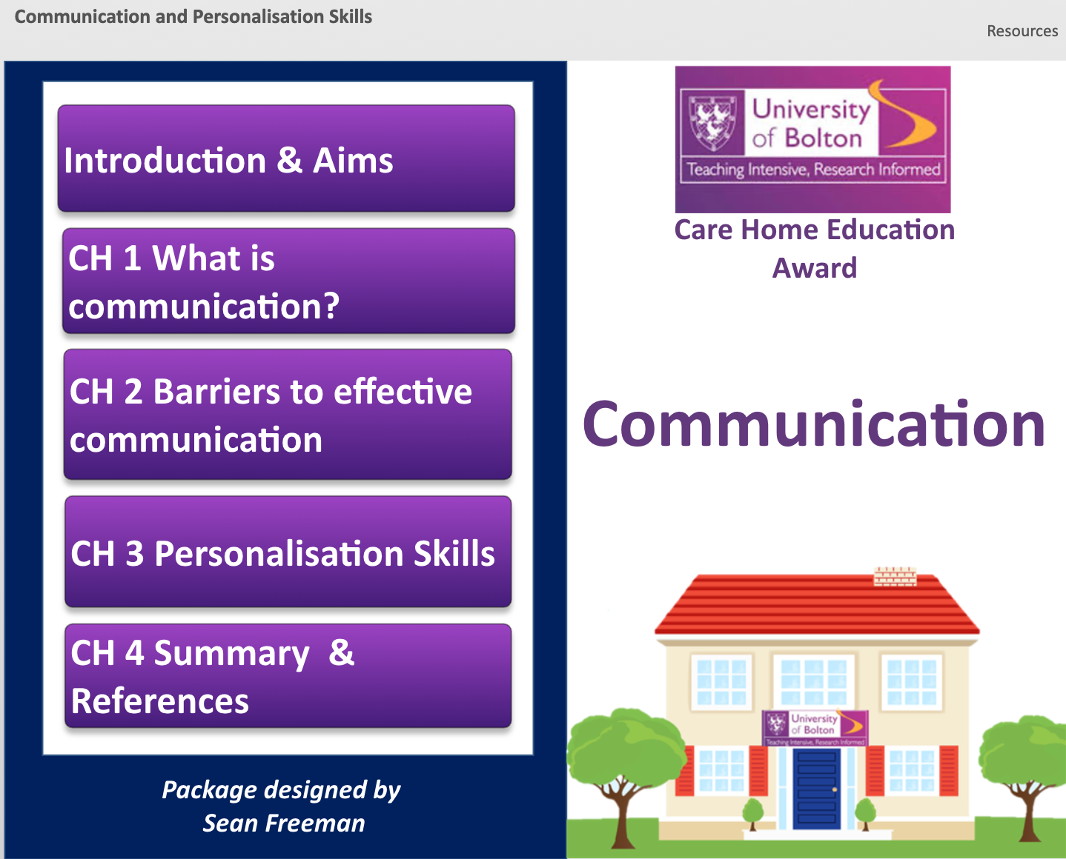
The Care Home Education Award
Design: ‘You said we did’
A blended approach: online and face to face teaching sessions​
​
Personalised education- facilitated by a University representative​
​
Quality Assured:​
Developed using the latest research and the knowledge and skills with the support of lecturers across the faculty including AHP’s, Specialist Nursing and Social care professionals.
University of Bolton Care Home Education Award

Slide 11


Programme Design
Overcoming the barriers
Flipped classroom session. Materials developed using the latest online package from Articulate.​
​
Workshop facilitated by a University Lecturer who has experience of working within both care homes and the acute sector​
​
Networking session allowing delegates to discuss learning and share experiences and ideas to support care delivery ​
​
Assessment of learning through short quizzes incorporated into the package and reflections linking theory to practice.
University of Bolton Care Home Education Award

Slide 12
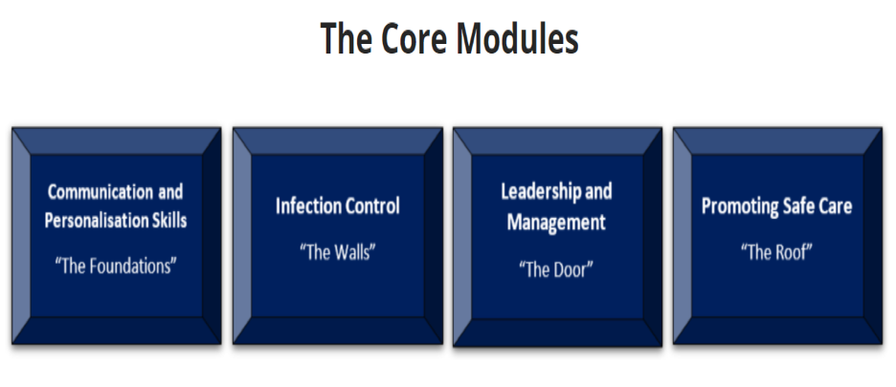
Programme Content
University of Bolton Care Home Education Award

Slide 13
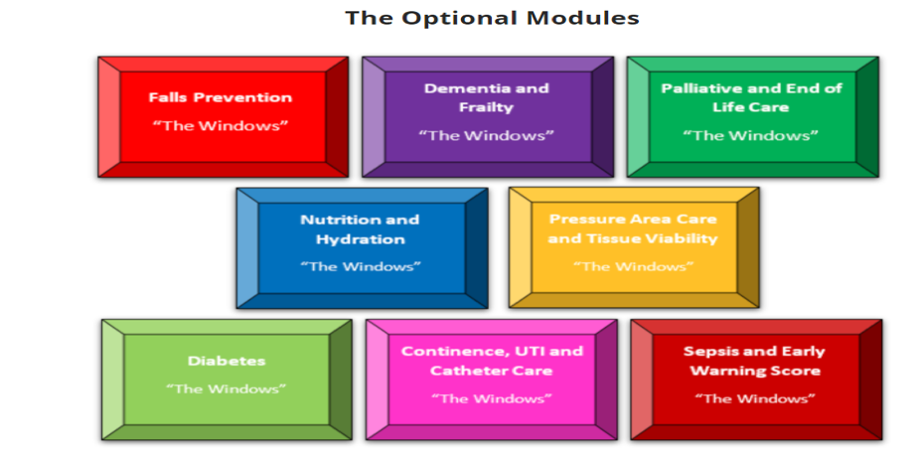
Programme Content
University of Bolton Care Home Education Award

Slide 14
Video

Slide 15
Providing opportunities
Developing educational experiences which are bespoke for those working within the independent sector​
​
Enhance integrated working and team working across the health and social care sector and within the home.
​
Provide opportunities for care homes staff to progress in their careers.
​
Identify staff who already have the knowledge and skills to work at higher levels such as those with overseas qualifications or previously gained qualifications and support them to utilise their knowledge and skills to the best advantage for the residents, themselves and the home.​
​
Valuing and supporting this essential workforce to continue to deliver high standards of care to our elderly and most vulnerable population​
​
Providing a research opportunity to inform the evidence base using evaluation and data to support people and workforce development across Greater Manchester
University of Bolton Care Home Education Award

Slide 16
The Manager
If you were a care home manager, what would be important to you?

Slide 17
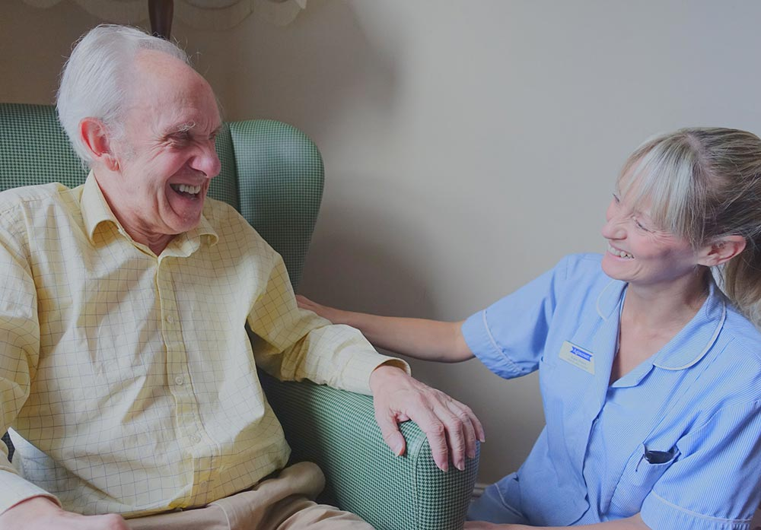
The Care Homes
Two nursing homes
One residential homes
The University of Bolton Care Home Education award has been supported by each registered manager.
The feedback from registered managers
“It’s the first time we have collaborated with a university – we would like to explore further opportunities once this programme has completed i.e. programmes for registered nurses”
“We’ve had some really good feedback from the university on our students progress”
“Ours students feel valued by the university”
“Our students have demonstrated newly acquired knowledge”

Slide 18
The Student
If you were a carer in a care home, what would be important to you?

Slide 19
The Students
11 Students
10 Females
1 Male
Diverse Backgrounds
Pre-existing qualifications
Length of experience
These include students who have gained a PhD through to students who have completed NVQ’s
The students on the programme have varying length of experience in health and social care – 6 months – 22 years.

Slide 20
The Students Feedback
To-date the students have completed seven modules.
We have received 17 completed feedback forms from the students.

Slide 21
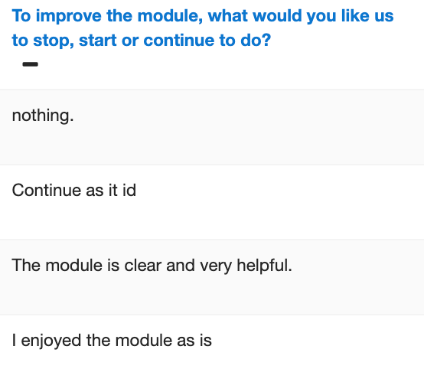
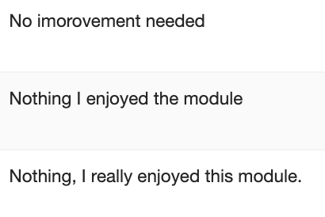
The Students Feedback
“Previously all my training was provided by the care home – I was really excited to start this programme’.
‘The feedback from the programme tutor has motivated me. Its has helped improve the care I give to residents’.
“We learn from each other in the home, its good to have the right right knowledge and learn from the programme tutor’.
“I felt stuck in a rut before this course, I didn’t know how to progress in my career’.
“I hadn’t considered a career in nursing until this course”.

Slide 22
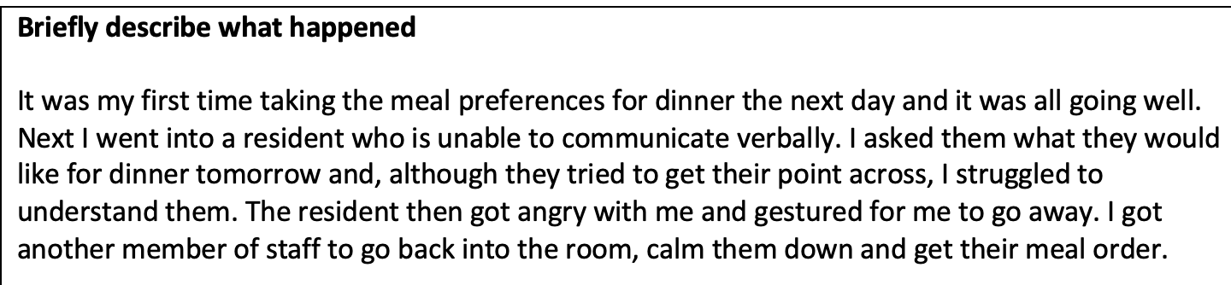
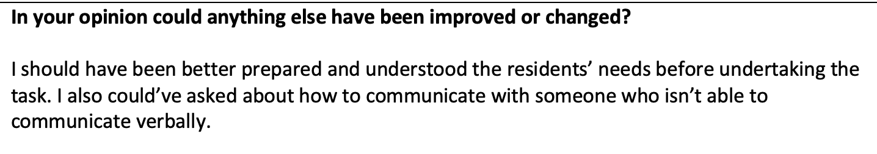
The Students Submitted Reflections
Students are required to submit a reflection for each of the modules.

Slide 23
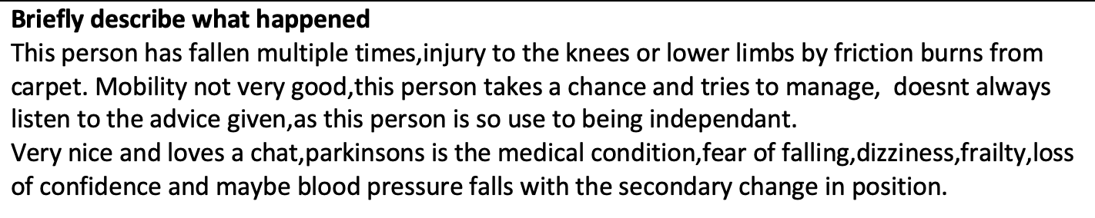
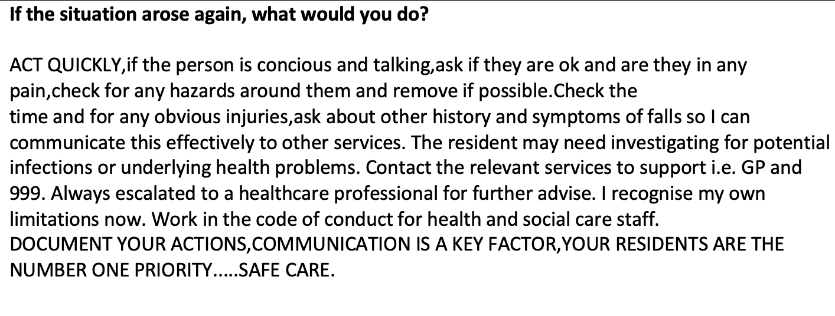
The Students Submitted Reflections
This student has demonstrated newly acquired knowledge.

Slide 24
Research Outcomes
The aim of the research is to evaluate the pilot and to create a model for care home education delivery.
Future research to inform practice.
To monitor and measure the outcomes of the pilot programme of education through data analysis.
Supporting the development and delivery of standardised quality assured education in line with ‘The Framework for Enhanced Health in Care Homes’ Version 2 2020 NHS E/I

Slide 25
Any Questions?

