Slide 1
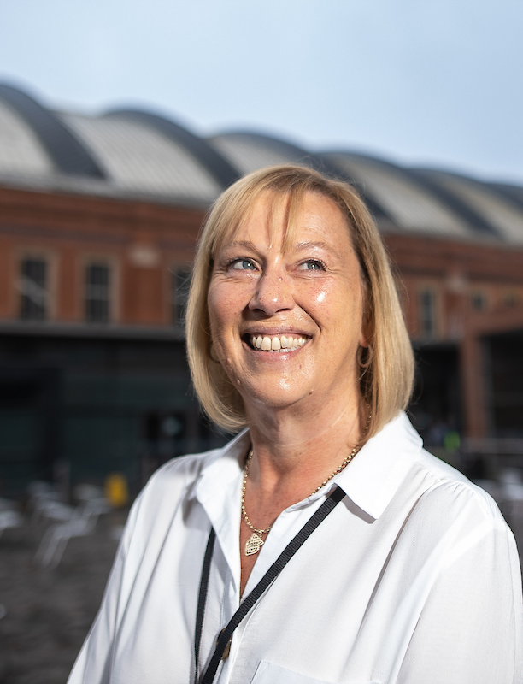
Greater Manchester Health and Care Workforce Summit
Lessons from building NHS Nightingale Hospital North West
Janet Wilkinson, Exec Lead for Workforce, OD and System Leadership, Greater Manchester Health and Social Care Partnership

Slide 2
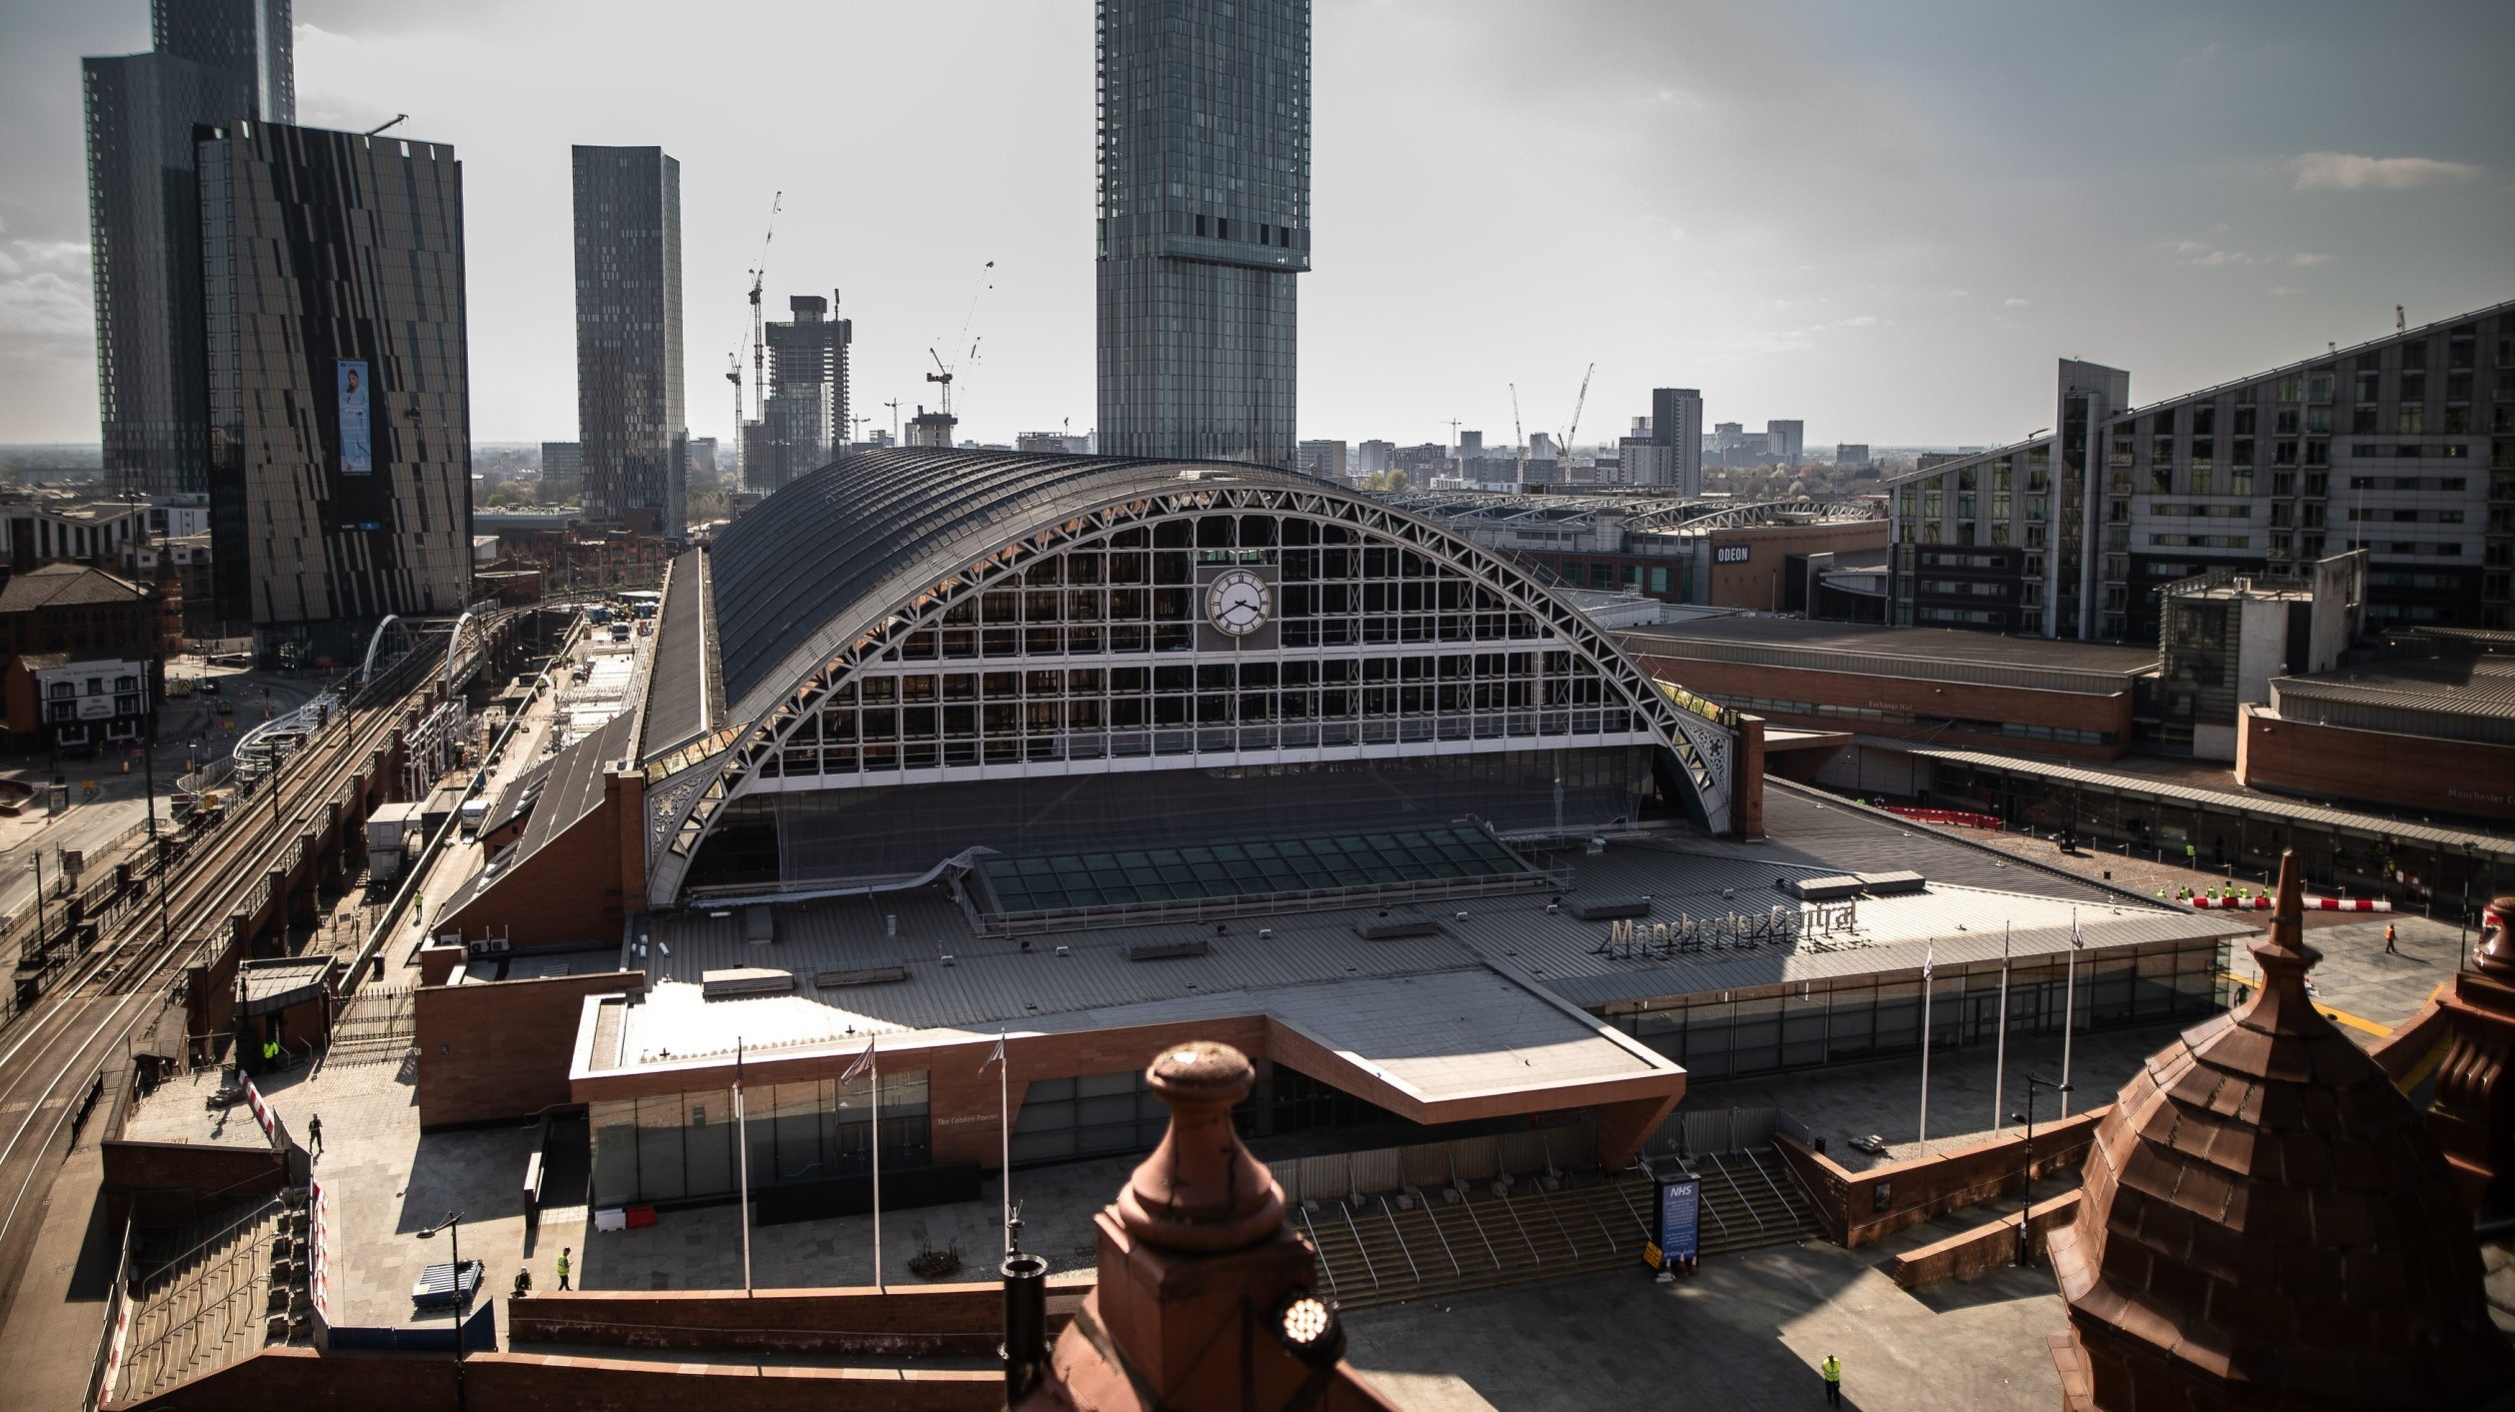

Slide 3
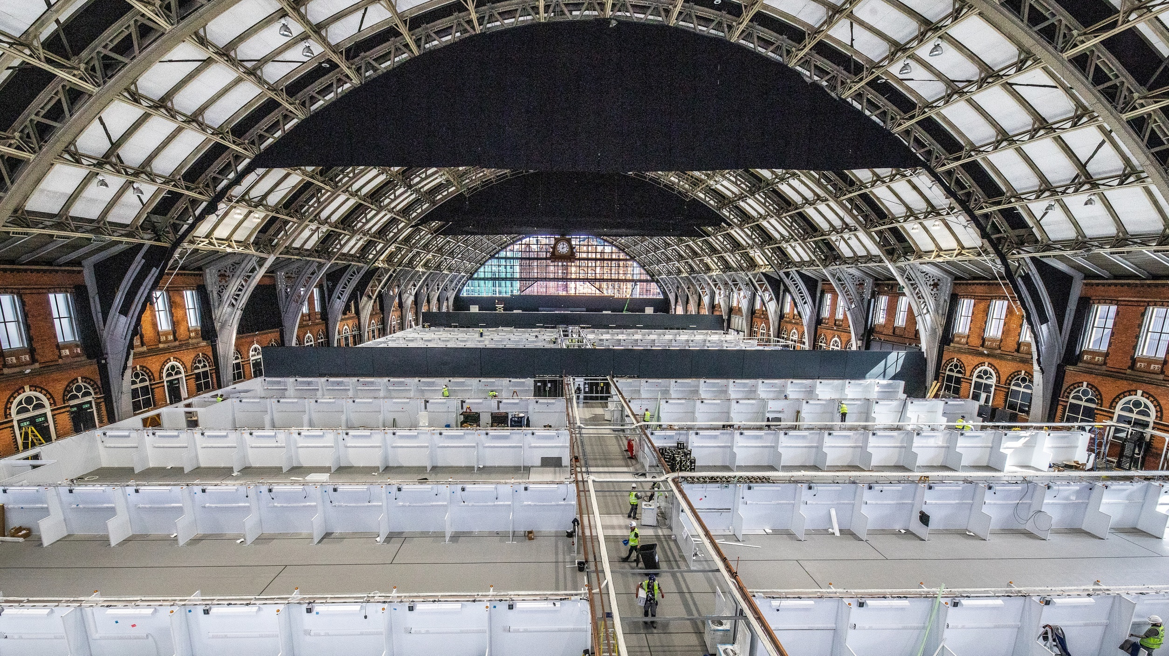

Slide 5
Our task
To recruit a team at pace to a new hospital, without destabilising our neighbouring healthcare providers and while also putting approaches and processes in place to support our workforce for the time they were with us.
Shortly before opening a host trust was confirmed (Manchester University NHS Foundation Trust), however due to the pace and scale of the task, alongside huge service pressures across the NHS, we recruited a dedicated Workforce Team to take on this challenge.

Slide 6
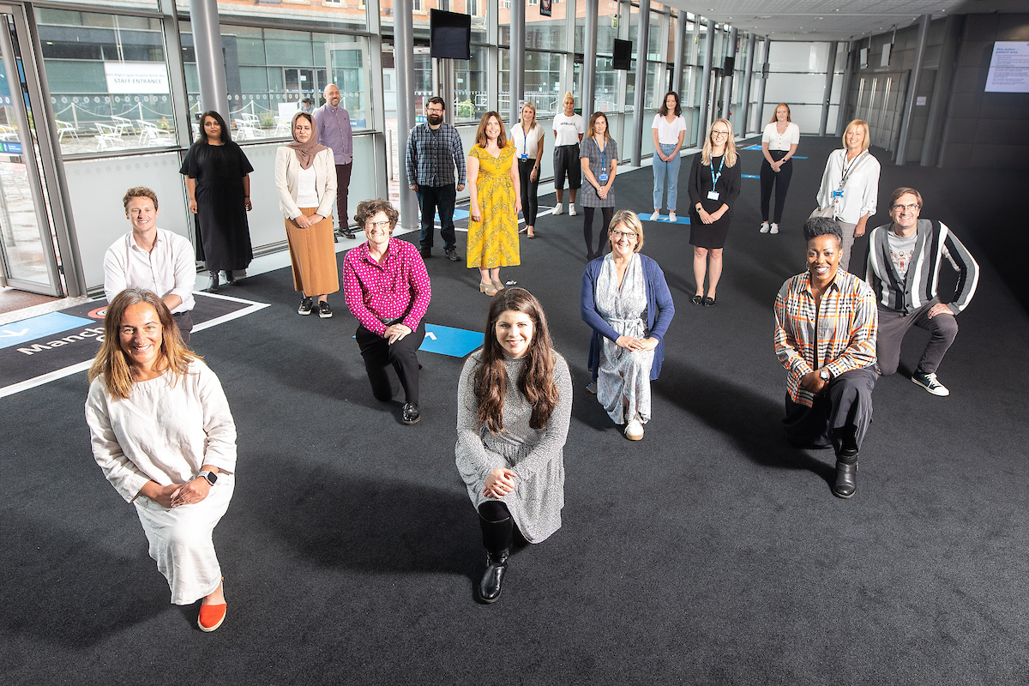
Our team

Slide 7
Opportunities
A clear call to action and purpose to encourage people to step forward
Current labour market: people furloughed or out of work due to COVID 19
Support from our regional healthcare system
Being able to build something from nothing – using our learning and experience to do things differently
To create bespoke employment models, utilising national agreements as appropriate
Not being afraid of the art of the possible – being motivated to create the best possible workforce experience
Operating in pandemic requires fast actions, which makes for effective decision making

Slide 8
Challenges
To recruit our team without drawing valuable resources away from other healthcare organisations
To create a sense of belonging and team spirit in a new and temporary organisation, with different employment arrangements and individuals from a variety of backgrounds
To build workforce systems and processes that supported the nature of the hospital
To make sure our team felt supported – with extraordinary challenges and home situations.
To be inclusive in a crisis, where the tendency is to make quick decisions without considering the equality impacts of those approaches
To do ALL of this in less than two weeks!

Slide 9
Our approach
1.
Looking after our people
2.
Belonging
3.
New ways of working and delivering care
4.
Growing for the future
Focussing on delivering a positive experience for all our team; supporting their physical and psychological wellbeing
Developing strong and collegiate relationships with all our team; working to a shared purpose, with clear and intentional culture and values
To build and recruit to a new organisation at pace with an innovative and agile approach to recruitment, onboarding and HR processes.
To create a proactive learning culture to provide our workforce with opportunities to develop new skills, competencies and future career opportunities.

Slide 10
Our workforce journey
1/6/20
NHS E/I announce NNW to be placed on standby
Begin offboarding in line with patient numbers
30/3/20
Workforce and recruitment team mobilised
13/04/20
Open first 32 beds and receive our first patient
Across June 2020
261 colleagues attend Debrief sessions
8/4/20
Launch purpose, vision & values
10/4/20
First group of staff inducted
24/6/20
Discharge our last patient
9/4/20
Launch health & wellbeing offer
12/4/20
Go Live Roster Validation
28/4/20
Mobilised recruitment to staff up to 72 beds
11/5/20
Mobilised recruitment to staff up to 108 beds
Team Building introduced for all staff
15/6/20
Pulse staff survey launched to all staff with Affina OD
26/6/20
Standby ceremony & STAR awards
4/4/20
NHSP Recruitment Campaign Go Live

Slide 11
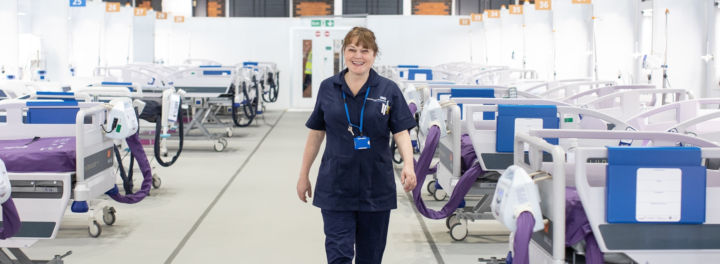
What we did

Slide 12
Looking After Our People
People Offer
To provide the practical support and considerations to support our team and help combat the impacts of the pandemic on the whole lives of our people.
Wellbeing
To support our biggest resource - our people - to be their best. Therefore, to develop a wellbeing offer in a real time and relevant way, heightened by the nature of the pandemic.
Engagement
To make sure our people felt informed, listened to and valued, and ultimately engaged as members of the Nightingale North West team.

Slide 13
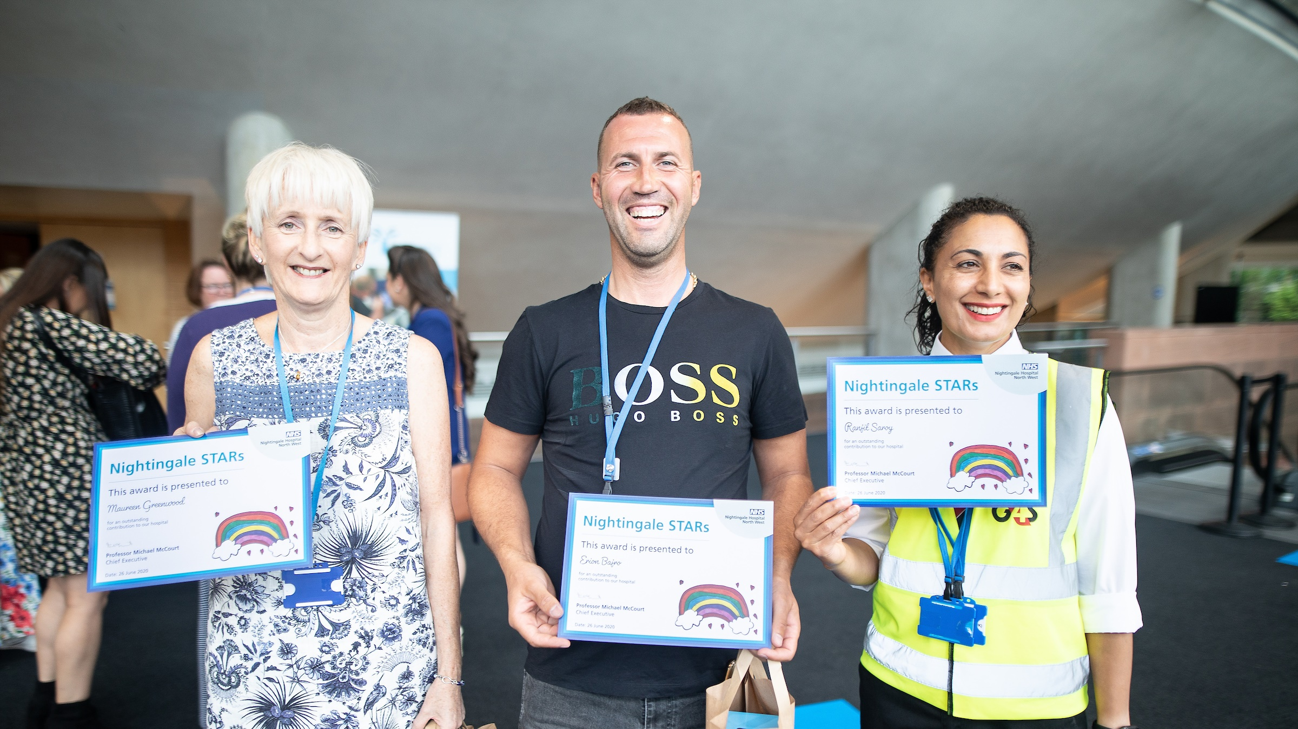

Slide 14
Union engagement
Engagement forum identified via GM Workforce Engagement Forum
Union support promoted to all staff through internal communication channels
Our contracted workforce
Lesson learned – greater involvement of trade union colleagues from Day One

Slide 15
Belonging
Values and Culture
To develop a simple, clear and inspiring purpose and set of values that leaders and teams could easily process and underpin their approach to the delivery of the best possible patient care.
Leadership
To develop a leadership team which could respond quickly in a fast-paced project whilst upholding the values and culture of the organisation
Equality, Diversity and Inclusion
To be intentional about equality, diversity and inclusion during a crisis.
Team Development
To bring together a diverse group of people with a variety of employers and contracts, in an emergency situation, and create a cohesive team in service of the purpose of the organisation.

Slide 16
Vision
Mission
Values
Conceptual Component
Physical Component
Mental Component
Your Bit!

Slide 17
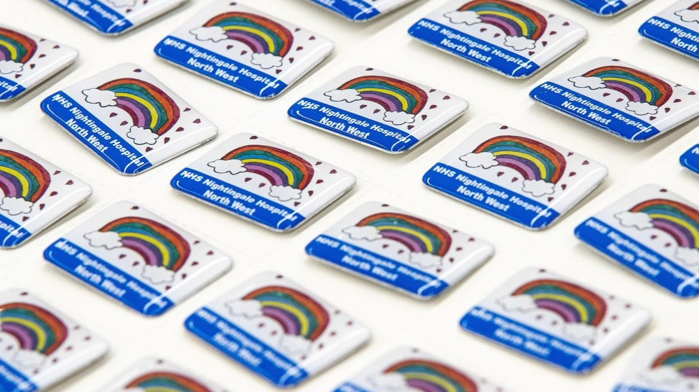

Slide 18
New ways of working and delivering care
Organisational Design
To design and build an organisation in 13 days with a clear purpose and an agreed structure.
Recruitment
To deliver a rapid recruitment strategy to ensure sufficient people were recruited to enable the hospital to initially open on limited beds and scale up operations over an agreed time period.
Onboarding and Induction
To provide a robust and positive onboarding and induction experience for all people.
Rostering and payroll
To design, implement and manage a rostering and payroll solution, when the normal organisational infrastructure was not in place.
Offboarding
To develop a robust and positive off boarding experience for our workforce.

Slide 19
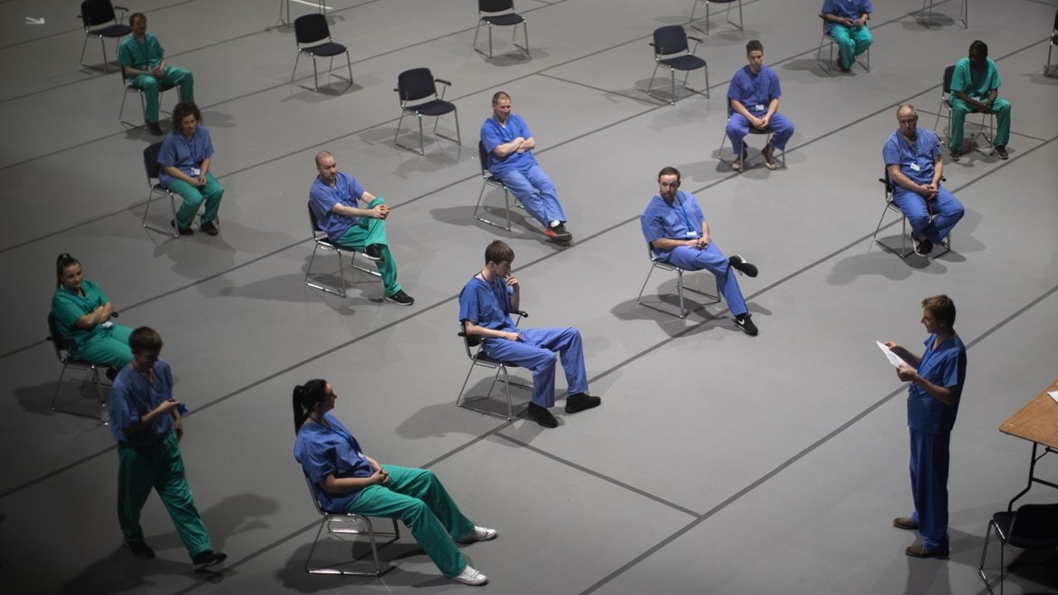

Slide 20
Growing for the future
Creating a learning culture
To create a proactive learning culture to provide our workforce with plentiful opportunities to develop new skills; competencies and future career opportunities.
Education and training
To invest in the cultural and technical development of our staff, to support delivery of care and services to the highest standard, whilst adopting a One Team approach.

Slide 22
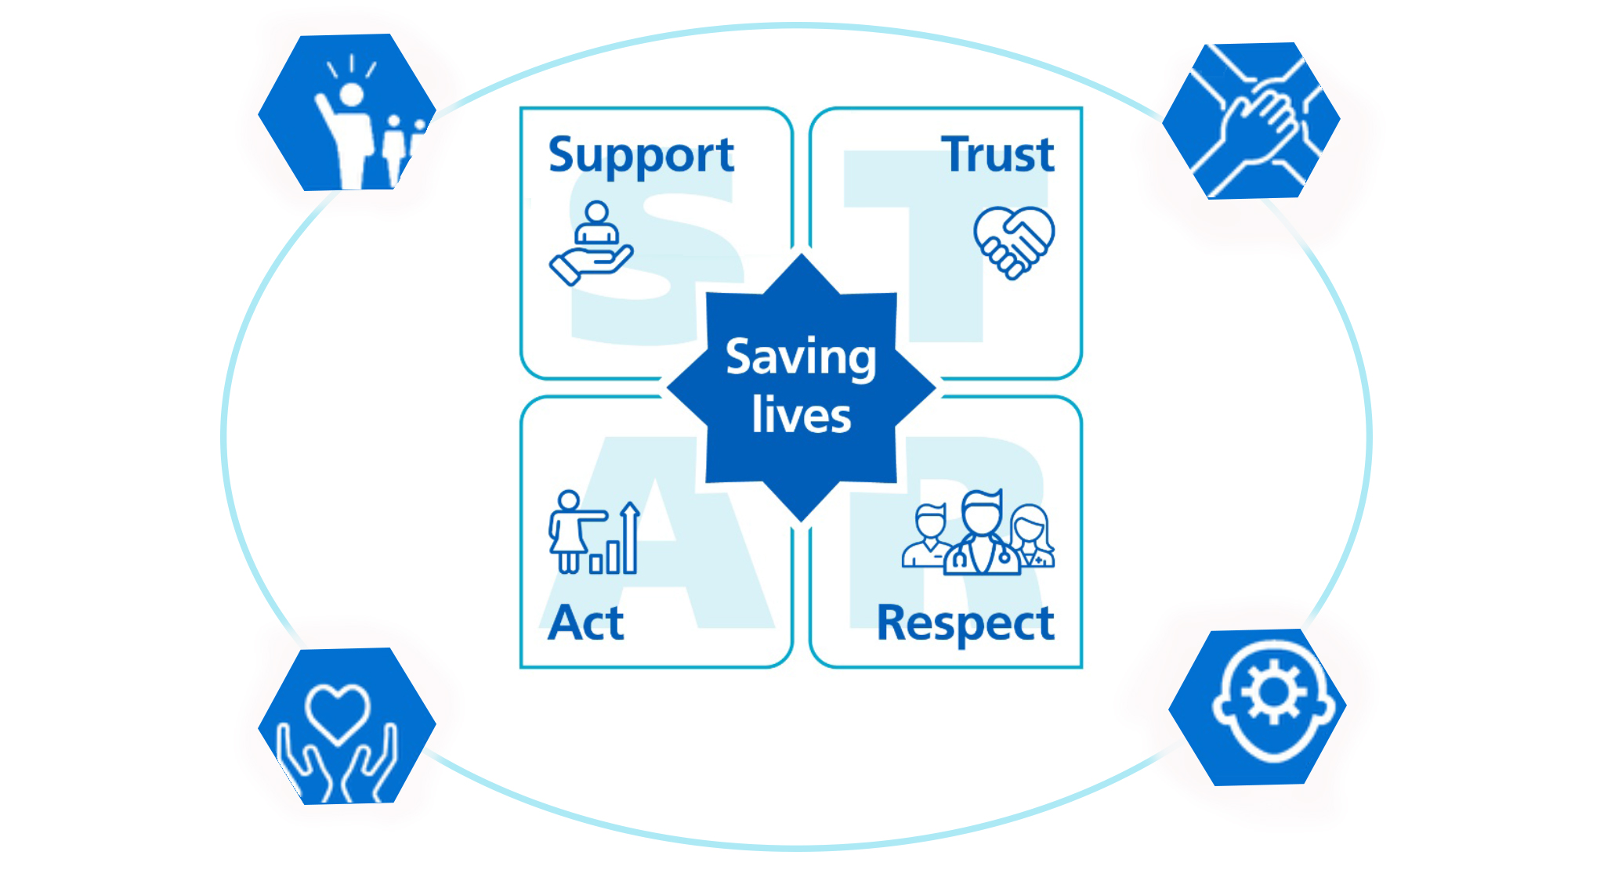
Our people approach
New ways of working and delivering care
Organisational Design
Recruitment
Onboarding and induction
Rostering and payroll
Offboarding
Belonging
Values and culture
Leadership
Equality, diversity and inclusion
Team development
Looking after our people
People offer
Wellbeing
Engagement
Growing for the future
Creating a learning culture
Education and training
Our purpose and values at the heart of our culture, owned by everyone and driven from the top by our leaders.

Slide 23
Key findings
The following results are collated from our pulse survey, with a response rate of approx. 25% of the total workforce.
88% felt the organisation had Clear Values
92% held Compassion for Patients as critical
87% felt a strong sense of Inclusion and a Sense of Belonging
86% were confident in their Wellbeing Offer
76% felt they were able to Access Leaders
88% felt they were working in an Innovative way
82% highlighted the Clear and Open Communications
85% were confident in Working with Other Teams, with
81% felt empowered to Lead Change, and
89% confident to work in an inter-team setting.

Slide 24
Key findings - debriefings
The ability to make decisions and create change at pace has been a great experience.
The culture of the organisation was excellent and enabled me to be my best.
I have decided to change the path for my career, and had never considered the NHS as an employer before.
There was great strength in recruiting so broadly, as we attracted people we would not have normally recruited - who have blossomed here.
It is important to understand the things that enable staff to feel valued as it produces a work environment where people work well, ask questions and provide discretionary effort.

Slide 25
Our learning
We didn’t always get it right and we were only a small cog in a much bigger system responding to the pandemic, but building a hospital from scratch allowed us to do things differently.
As a team we learnt so much from our Nightingale experience. Here are the big things we are taking a way with us.

Slide 26
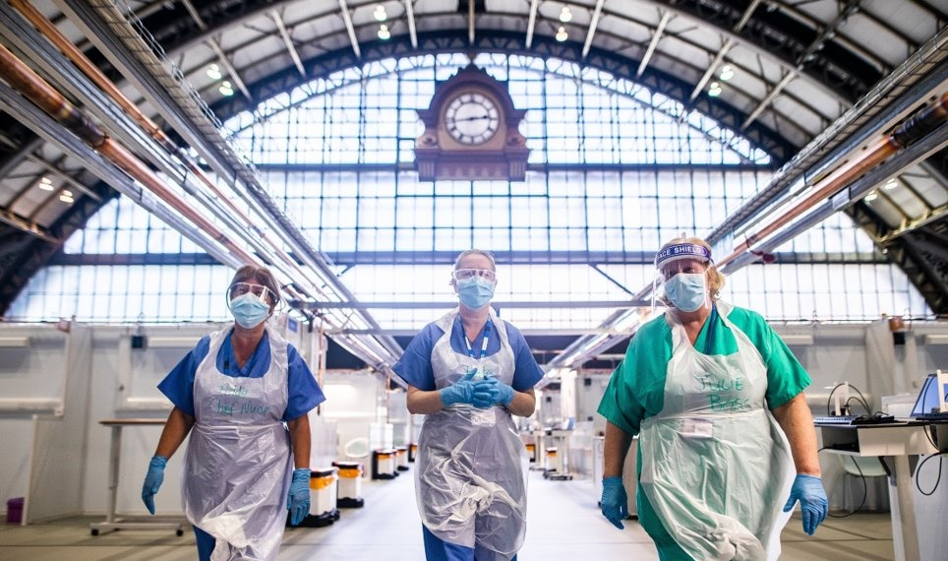
Leaner and more effective structures and hierarchies where people are encouraged to have purpose and autonomy whilst being supported to master their skills produces teams who deliver great service and go the extra mile.

Slide 27
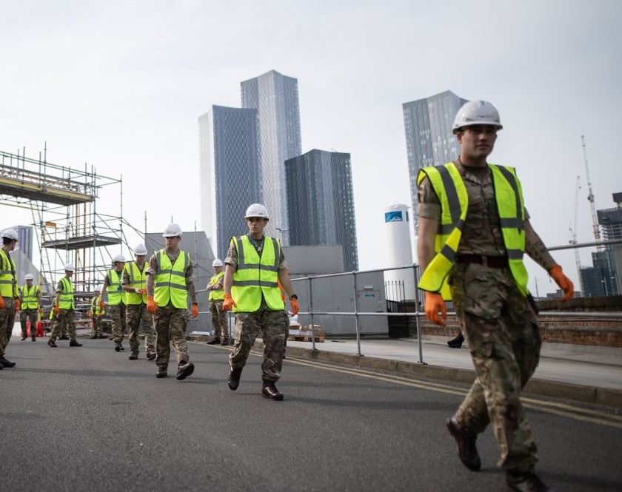
The development of culture, vision and values should be succinct and easy to understand. This then needs to be weaved through every aspect of the workforce experience in order to be meaningful and to inspire ownership.

Slide 28
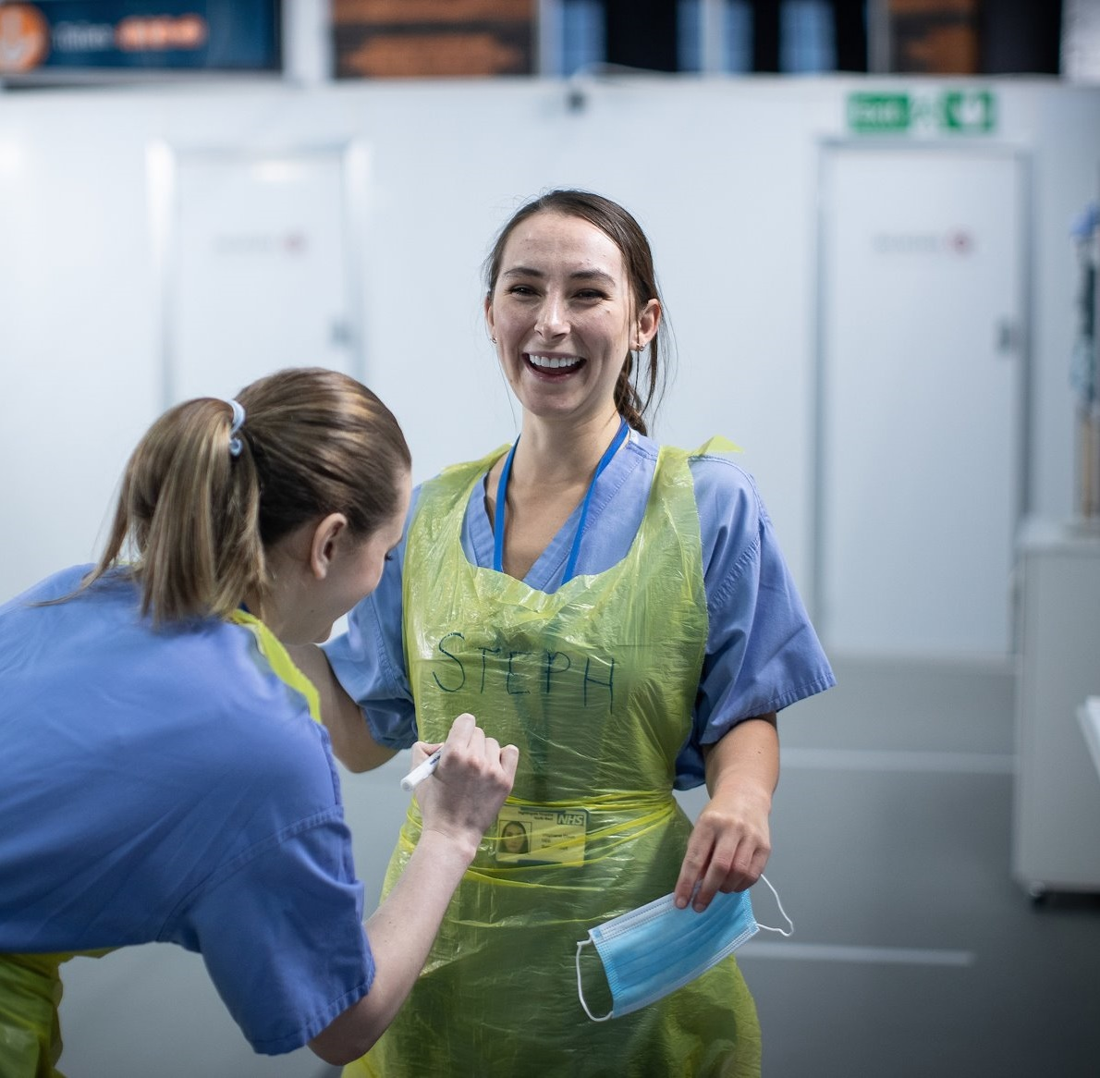
The true value of your stated culture does not come from the development of the words, but engagement with the workforce in delivering it.

Slide 29
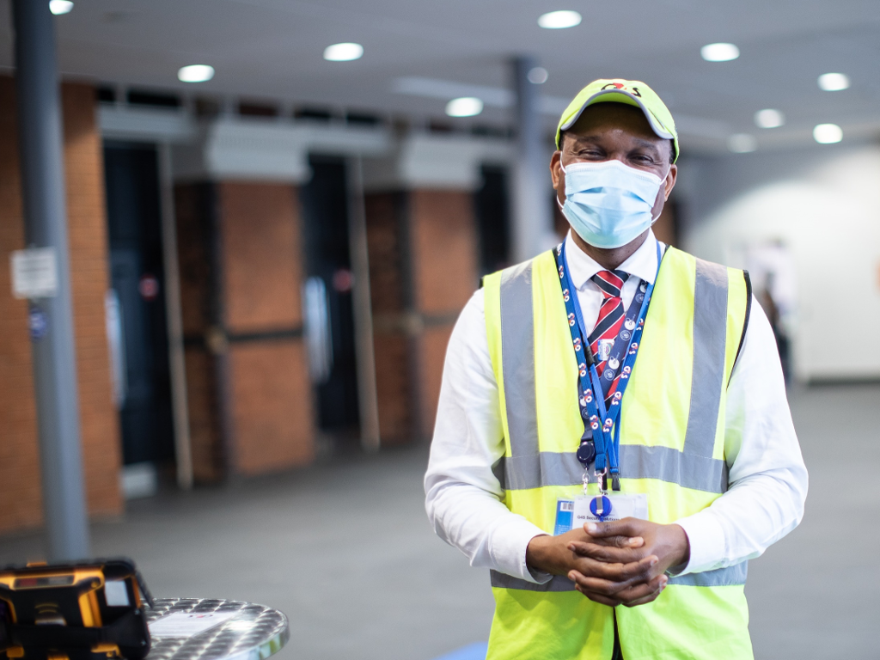
When we have an authentic approach to wellbeing we produce an environment in which people feel safe and well looked after. This approach supports people to deliver the kind of services we are looking for.

Slide 30
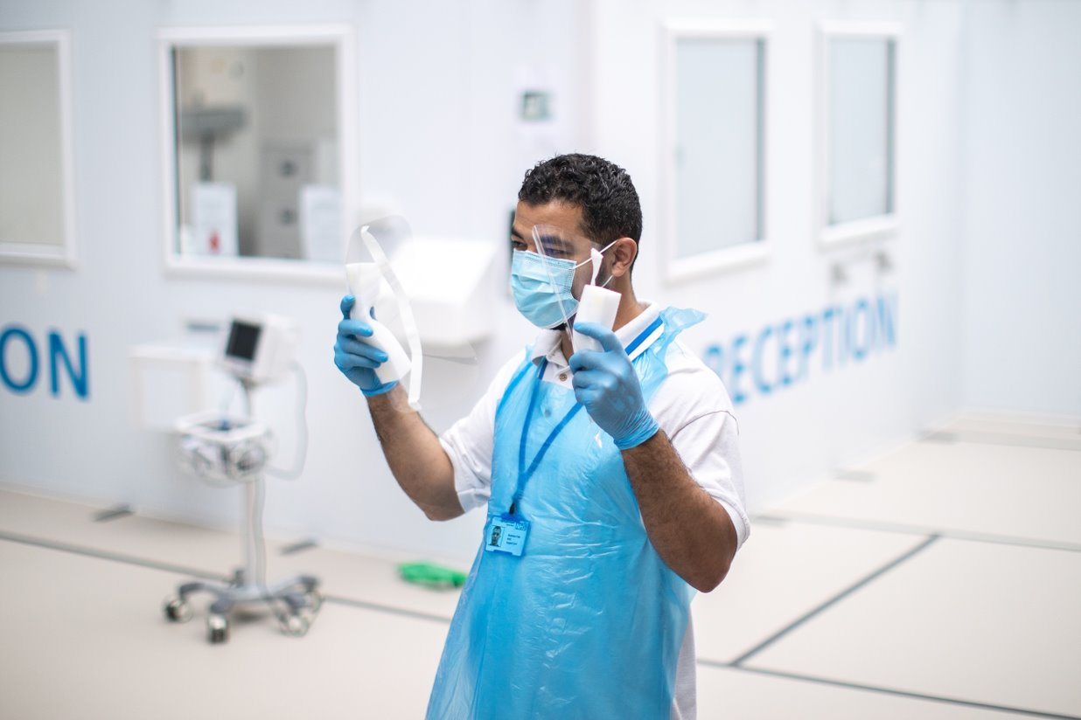
Creating a culture where people feel respected and able to act, encourages people to speak up about what they have to offer or what they need from a learning perspective to create a strong learning culture.

Slide 31
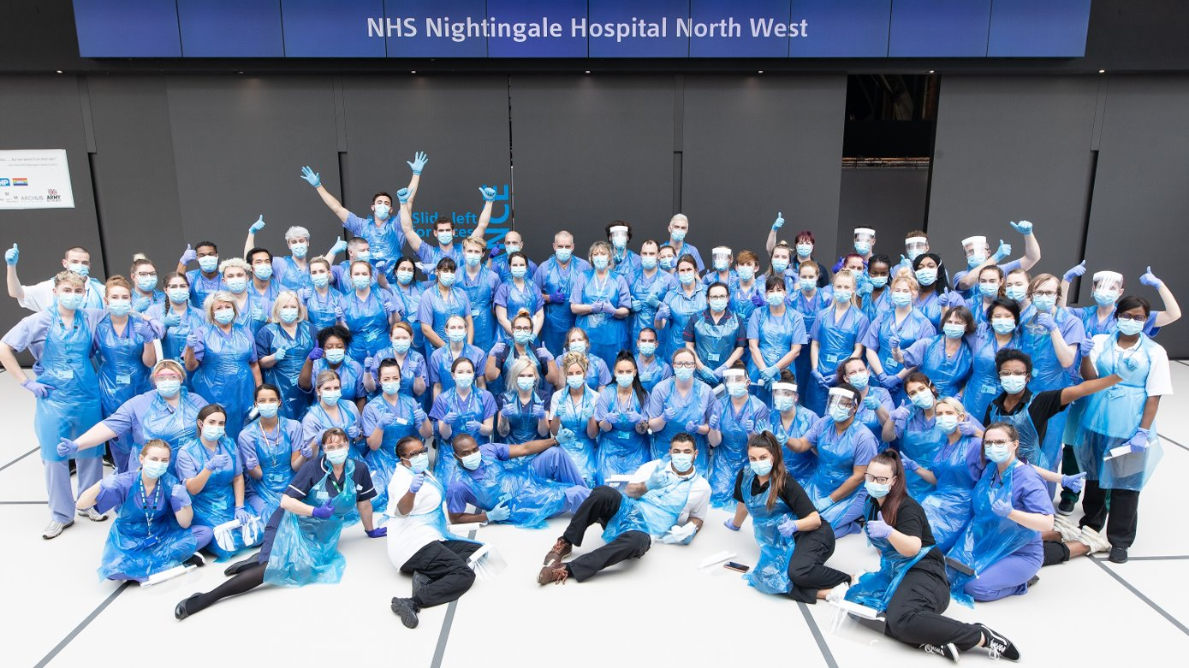
When we have an intentional inclusive approach to recruitment and building a team, we create a workforce that reflects the communities we are looking to serve. This approach must run throughout the organisation; from recruitment through to how individual teams operate.

Slide 32
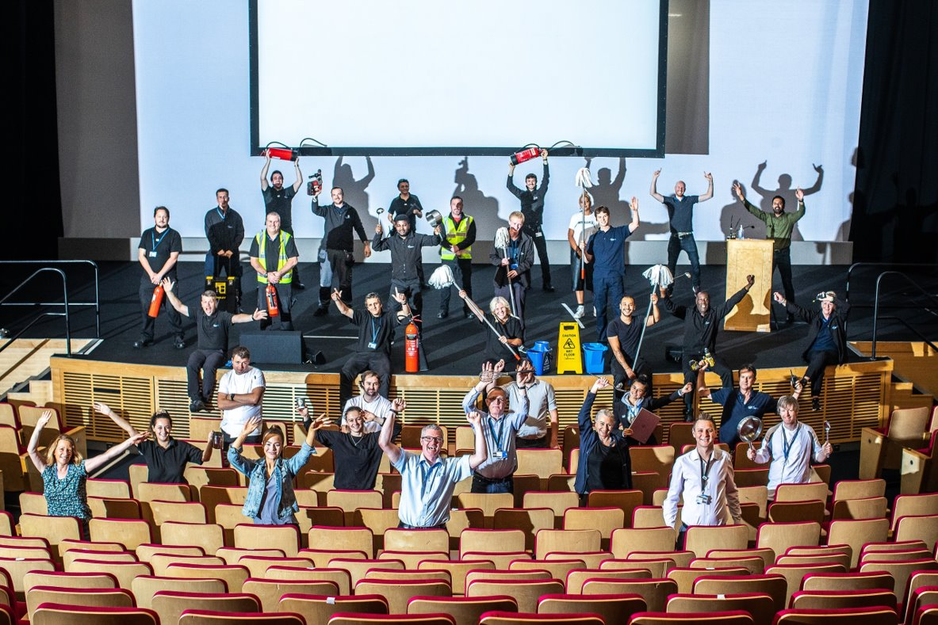
The pandemic alongside a clear call to action has supported the NHS recruitment drive. If we go onto look after those recruits, we make them feel valued and support them to develop, we can help build a future workforce.

Slide 33
Reactivation

Slide 34
Any questions?

