Slide 1
Leadership Through the Lens of Health and Wellbeing

Slide 2
Agenda
Welcome
Scene setting:
National
Regional - HWB journey at NHS NWLA
The commission
The approach
The outputs
Where we need your help and how to get involved
Q&A

Slide 3
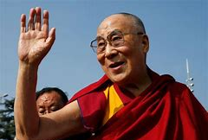
“If we try to secure the well-being of others, we will at the same time, create the conditions for our own”

Slide 4
Connecting and Sharing
What are you doing to secure the
well-being of others and yourself?

Slide 5
Scene setting - HWB Culture Journey

Slide 6
NHSEI – A Culture of Wellbeing
Health and Wellbeing Conversations
Supportive conversation about wellbeing, in and out of work
For all NHS People, at least annually, to develop a personalised plan
Guidance and support materials launching imminently
Wellbeing Guardians
Board level Champion for Wellbeing
Introduced over the next 12 months
Health and Wellbeing Framework
Refreshed early 2021
More holistic, additional focus on culture and wellbeing

Slide 7
NHS NWLA - Scope of the Commission
Scope - Commissioned exploratory work to support NHS NWLA Health and Wellbeing (HWB) leadership development workstream activity, focused on the relationship between HWB and leadership.
Intent – Explore and shape the leadership behaviours that enable and encourage positive approaches to HWB for individuals, teams and organisations, enabling positive and healthy workplace cultures.

Slide 8
The Approach
Validating the ‘healthy leadership’ framework
Map the final framework against 3 existing frameworks to validate e.g. Healthcare Leadership Model, HSE Management Standards Framework, CIPD framework
Identify ‘healthy leadership behaviours’ data collection
Identify ‘healthy leadership behaviours’ from literature
Desktop literate review and validation of the research with HWB ‘experts’ - peer review by Prof Cary Cooper, Dr Steve Boorman, Jean Jenkins
Developing the ‘healthy leadership’ competency framework
Validate and refine the framework with focus groups
Final report
Framework which outlines leadership behaviours that promote health and wellbeing in the workplace
Insights from stakeholders around what could be done embed the framework
1:1 interview
Integrate the data into the initial behaviour framework.
Desk top review (peer reviewed)
Twitter chat and supplementary survey for those not able to contribute via twitter
Survey and Twitter chat

Slide 9
The Outputs
Scoping exercise to shed light on leadership through the lens of HWB, including:
Review of literature and evidence base
Engagement and testing conversations with key stakeholders
Utilising these insights to shape a framework which outlines the leadership behaviours that encourage and determine a culture of health and wellbeing for individuals, teams and organisations
Insights from stakeholders around what could be done on a system level to promote a culture of health and wellbeing
Spinoff’s
International Stress Management Association (ISMA) invitation to publish in their commemorative book (which will be published as part of their online global stress and wellbeing summit (https://isma.org.uk/isma-online-global-stress-and-wellbeing-summit)

Slide 10
Healthy Leadership Twitter Chat – 29th September 2020
Aim: Engage and connect in a conversation to scope out the leadership behaviours that enable, encourage and promote employee wellbeing in the workplace.
Twitter Chat Questions
What leadership/management behaviours positively impact on health and wellbeing at work?
What leadership/management behaviours negatively impact on health and wellbeing at work?
What things do you do personally that positively impact on your health and wellbeing at work?
What gets in the way of you looking after your own health and wellbeing at work?
What health and wellbeing interventions have the most positive impact on health and wellbeing at work?
What could the NHS NWLA do now and in the future to support the development of ‘healthy leadership’?

Slide 11
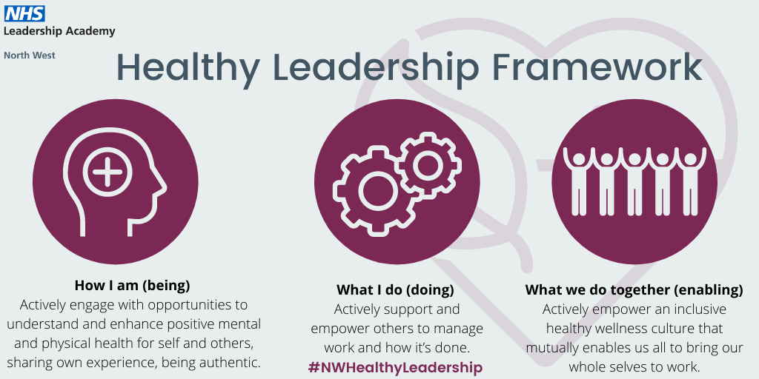
Preview of the Healthy Leadership Framework

Slide 12
Preview of the Healthy Leadership Framework
How I am
Positive Presence
Self Care
What I do
Leading Task
What we do together
Caring for and developing others
Relating to others
How I am (being) – Actively engage with opportunities to understand and enhance positive mental and physical health for self and others, sharing own experience, being authentic. 13 positive behaviours and 9 negative behaviours.
What I do (doing) – Actively support and empower others to manage work and how it’s done. 15 positive behaviours and 9 negative behaviours.
What we do together (enabling) – Actively empower an inclusive healthy wellness culture that mutually enables us all to bring our whole selves to work. 18 positive behaviours and 6 negative behaviours.

Slide 13
Leadership/management behaviours that contribute positively to employee wellbeing | Leadership/management behaviours that contribute negatively to employee wellbeing
1.1+ being open, honest and transparent (authentic) | 1.1- not always role modelling positive health and wellbeing behaviours (e.g. wearing long hours as a badge of honour)
1.2+ being a good health and wellbeing role model (walking the talk) | 1.2- not regularly communicating about health and wellbeing
1.3+ behaving in accordance with organisational values | 1.3- lacking empathy
1.4+ talking optimistically about the future and remaining positive in face of challenge (give hope) | 1.4- being distant, lacking visibility and not engaging with others
1.5+ showing vulnerability and humility (willingness to be critiqued, honest when don’t know the answer, acknowledging when one has made a mistake) | 1.5- bring unpredictable in mood and inconsistent in behaviour
1.6+ being committed to and promoting employee health and wellbeing | 1.6- lacking self-awareness
1.7+ speaking with confidence about mental health and wellbeing and taking appropriate action to support others | 1.7- letting emotions get the better of oneself (e.g. show frustration and or withdraw)
1.8+ being visible, accessible, approachable | 1.8- lacking transparency
1.9+ helping to create a climate where people can have fun, light-hearted upbeat humour, have a laugh | 1.9- paying lip service to health and wellbeing (e.g. failing to promote what’s available and/or only doing the basics)
1.10+ being self-aware and understanding how own behaviour impacts on others
1.11+ attending to and look after own health and wellbeing
1.12+ showing compassion toward self and kindness and compassion to others
1.13+ trying to always do the right thing (acting with integrity)
How I am (being)

Slide 14
Leadership/management behaviours that contribute positively to employee wellbeing | Leadership/management behaviours that contribute negatively to employee wellbeing
2.1+ being clear on values, expectations, setting clear objectives/goals and checking with individuals that they feel they are realistic and achievable | 2.1- focusing on targets and task at the expense of health and wellbeing
2.2+ demonstrating a consistent approach (being consistent in behaviour and decisions making) | 2.2- making short term demands rather than allowing planning (being reactive, changing goal posts, setting unrealistic deadlines)
2.3+ providing a compelling vision and giving clear direction | 2.3- not always clarifying roles, responsibilities, objectives or acknowledging competing priorities (e.g. laissez faire management style)
2.4+ encouraging others to collaborate and work collectively on tasks/projects | 2.4- being inflexible in one’s approach (e.g. applying a blanket approach to everyone)
2.5+ being fair, flexible and pragmatic in ones approach to applying policy and I adapting ones approach to meet individual need | 2.5- not always trusting others to do their job
2.6+ providing regular and timely communication, using different communication methods | 2.6- making decisions without consulting others (e.g. authoritarian /autocratic /command and control/directive style)
2.7+ helping teams meet regularly to review performance, make improvements (promoting reflexivity) and share learning to innovate | 2.7- being guarded and failing to provide enough communication
2.8+ flexing and modifying work scheduling to support others wellbeing and achieve work life balance | 2.8- not always acting on feedback or taking action to address matters raised
2.9+ listening to, considering and seeking others ideas | 2.9- not always listening, only casually listening to complaints, suggestions and ideas
2.10+ adopting the most appropriate leadership/management style depending on the context
2.11+ actively seeking feedback and taking action to address matters raised
2.12+ walking the floor to understand and acknowledge what it’s like to work around here
2.13+ trusting individuals and teams, giving them the autonomy and control to do their jobs (empowerment)
2.14+ taking responsibility for ones actions and hold self to account
2.15+ tackling bullying and challenge inappropriate behaviour
What I do (doing)

Slide 15
Leadership/management behaviours that contribute positively to employee wellbeing | 3.13+ appreciating others achievements by rewarding and recognising and celebrating success
3.1+ helping people connect to the wider meaning of their work, the contribution they make, creating a sense of belonging | 3.14+ regularly asking people how they are
3.2+ standing alongside ones team and getting involved with what they do when they need help | 3.15+ taking time to support others in their development
3.3+ respecting and valuing difference, taking an inclusive approach, recognising individuality and encouraging people to be themselves (embracing diversity) | 3.16+ being aware of full circumstances of the people one leads/manages and finding out what motivates them makes them tick
3.4+ getting to know people/teams on an individual level formally and informally (treating them as humans not just colleagues) | 3.17+ offering support to others
3.5+ coaching others to find their own solution (acting as a sounding board and challenging constructively)
3.6+ communicating and involving people in change management (increasing certainty and reducing uncertainty) | Leadership/management behaviours that contribute negatively to employee wellbeing
3.7+ demonstrating empathy by understanding other perspectives, personal circumstances and walking in others shoes | 3.1- focusing on oneself and what I want to achieve at the expense of the collective good (e.g. hero manager/leadership style)
3.8+ showing respect for others | 3.2- not always appreciating difference and diversity
3.9+ encouraging and facilitating connections between people | 3.3- sometimes favouring people who are more like me
3.10+ encouraging personal growth and resilience | 3.4- micromanaging others and disempowering them
3.11+ encouraging learning from error (learning culture) | 3.5- not always creating a safe environment to speak out (psychological safety)
3.12+ listening actively (non-judgemental, listening to how people are feeling) | 3.6- giving more negative than positive feedback, blaming and criticising and finding fault
What we do together (enabling)

Slide 16
Preview of the Healthy Leadership Framework
Reflections
What is resonating with you about ‘Healthy Leadership’?
How do you see ‘Healthy Leadership’ in your organisation, in your leaders and yourself?

Slide 17
We need your help….
Voting on the healthy leadership framework:
17th November - 1st December https://www.surveymonkey.co.uk/r/NWHealthyLeadership
Twitter Chat:
Tuesday 24th November, 6-7pm
@nhsnwla #NWHealthyLeadership

Slide 18
Q&A

Slide 19
Health & Wellbeing Resources & Offers
Our NHS People Health and Wellbeing Resources & Offers
Our NHS People Support for Leaders
Our NHS People Health and Wellbeing Conversations
Our NHS People Supporting offers in difficult times
Newly launched national suite of executive level offers, in particular ‘Support in difficult Times’
NHS NWLA Virtual Health and Wellbeing Offers

