Slide 1
Locality Workforce planning Facilitator
Train the Trainer Workshop
November 2021

Slide 2

Aims of the workshop
GM Workforce Planning Workshop
To walk through the OWOM model for workforce planning
To share some tools and methodologies you can use in the workforce planning process
To summarise and explore your role as a Locality Workforce Planning Facilitator
To give you opportunity to action plan and decide how you can best progress workforce planning in your locality

Slide 3

Workforce Planning Training
Workforce planning solutions
one workforce, one model approach
Virtual Workforce Information System (VWIS)
A bespoke tool making workforce analysis simple
Life-Long Learning Model (LLLM) Building an ICS learning & development framework
One Workforce, One Model
(OWOM)
Workforce Planning Training
Growing and upskilling of workforce planning practitioners & online toolkit
Workforce Planning Investment
Funding for localities to develop sustainable and integrated planning solutions

Slide 4

GM Workforce Planning toolkit
GM Workforce Planning Workshop

Slide 5
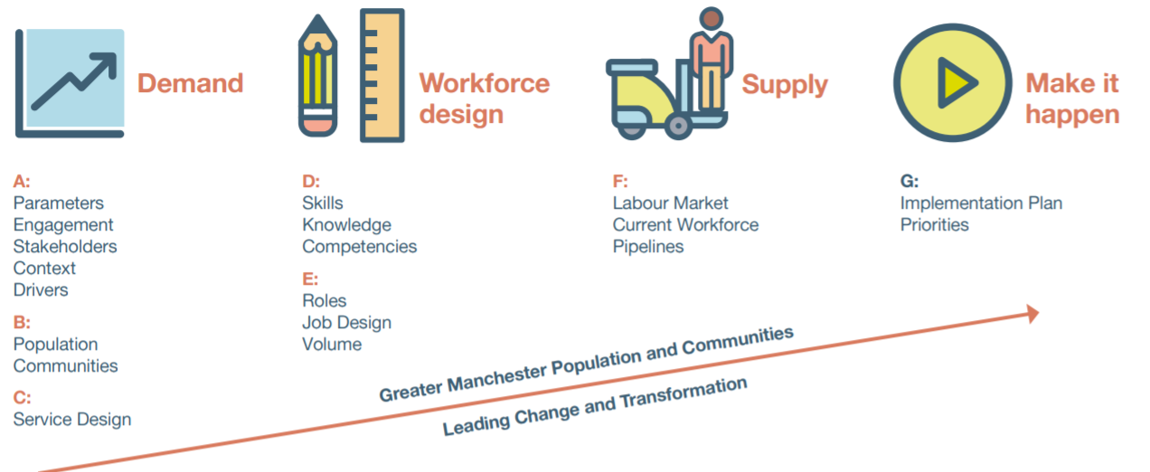
GM Workforce Planning Model
GM Workforce Planning Workshop

Slide 6

Domain: demand
GM Workforce Planning Workshop

Slide 7


Workforce planning checklist
GM Workforce Planning Workshop
Domain: Demand
Project Plan
Parameters, Engagement, Stakeholders, Context, Drivers
Have you defined who you are workforce planning for?
A
Scope
Timelines
Your role
Stakeholders
Change Management
Context and Drivers

Slide 8



Getting people on board with locality workforce planning: why?
What are the benefits?
GM Workforce Planning Workshop
Domain: Demand
Focus on population and communities
Ideal
Integration of planning processes (financial, service and workforce) at all levels
It’s not rocket science but takes investment of time.
Pragmatic
Uses work/ projects completed or underway
Takes a change management approach
Change and transformation
Lends itself to supporting organizational development

Slide 9
GM Workforce Planning Workshop
Domain: Demand

Slide 10

Change management:
Organisational and personal change
GM Workforce Planning Workshop
Domain: Demand

Slide 11
GM Workforce Planning Workshop
Domain: Demand

Slide 12

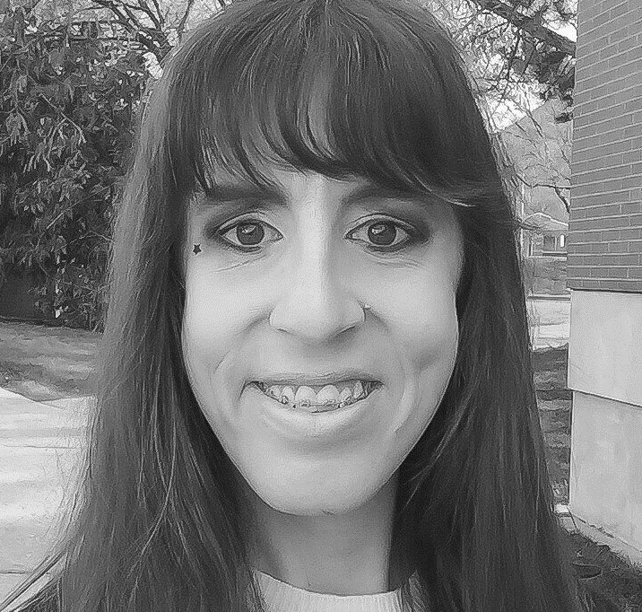
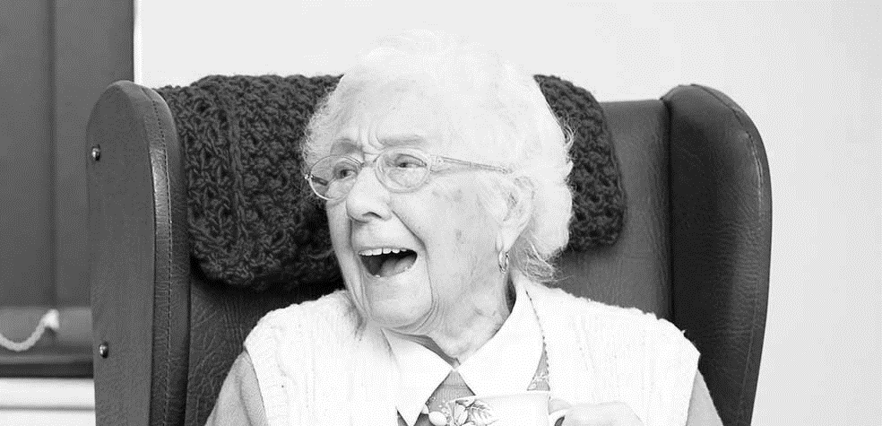
Getting to know your population: who are they? | get other involved | It matters!
GM Workforce Planning Workshop
Domain: Demand
B
Proxy 1 example
vera
Proxy example 2
asif
Proxy example 3 Lucy

Slide 13
Getting to know your population: who are they? | get other involved | It matters!
GM Workforce Planning Workshop
Domain: Demand
87 years old
Carers twice a day
Shield because of Covid-19
All the other health conditions
easily gets confused (indicative of early onsets of dementia)
Heart failure with increasing symptoms
One kidney as other was removed, 15 years ago due to cancer of the kidney
Hip replacement 10 years ago – but now scared to walk because of more frequent falls
Known to ambulance service due to these falls in house
Late onset diabetes
Lives with husband who is uncomfortable with carer support in the house and sometimes refuses them a visit, especially at night time
Proxy 1 - vera

Slide 14
Getting to know your population: who are they? | get other involved | It matters!
GM Workforce Planning Workshop
Domain: Demand
22 years old
Early signs of schizophrenia
Lived in hospital setting 16 – 21 years old
Struggled during his high school years, poor concentration span
has never been assessed for learning needs
Becomes very tired when with more than two people for any length of time
Enjoys and is very adept at PlayStation and computer based games
Evidence of some Self-harm
Lives with mother and father & younger twin siblings away at university
Becomes frustrated and will lash out, sometimes biting and scratching
ASIF

Slide 15
Getting to know your population: who are they? | get other involved | It matters!
GM Workforce Planning Workshop
Domain: Demand
Age 35
Trans woman part of the LGBTQ community
Has been living in temporary supported accommodation for over 10 years
Has a part time job, but frequently calls in sick as she struggles with depression and anxiety issues
Struggles with forming relationships with partners, or making friends and keeping friendship groups.
Health issues include: depression and history of eating disorder and substance abuse.
Lucy

Slide 16
Describing and understanding
OUR POPULATION AND COMMUNITIES
GM Workforce Planning Workshop
Domain: Demand
What intelligence and where from?
Who “owns” the intelligence locally?
How can you build that deep understanding?
How can you create a rich picture?

Slide 17
GM Workforce Planning Workshop
Domain: Demand
Service design
getting to know your proxies
C
How will you put yourself in the shoes of your proxies?
What techniques are already used locally?

Slide 18


GM Workforce Planning Workshop
Domain: Demand
Service design
getting to know your proxies
Data Detective
Journalist
Anthropologist
Impersonator
Co-Creator
Scientist
(Strategyzer.com
Osterwalder et al)

Slide 19
GM Workforce Planning Workshop
Domain: Demand
Service design
around your proxies
Monitoring Services
Diagnostic Services
Treatment Services
Mobilising Services
Daily Living Services
Befriending Services
Transport Services
Existing Service Plans and Models
Existing pathway work
Existing transformation work
New Service

Slide 20
GM Workforce Planning Workshop
Domain: Demand

Slide 21
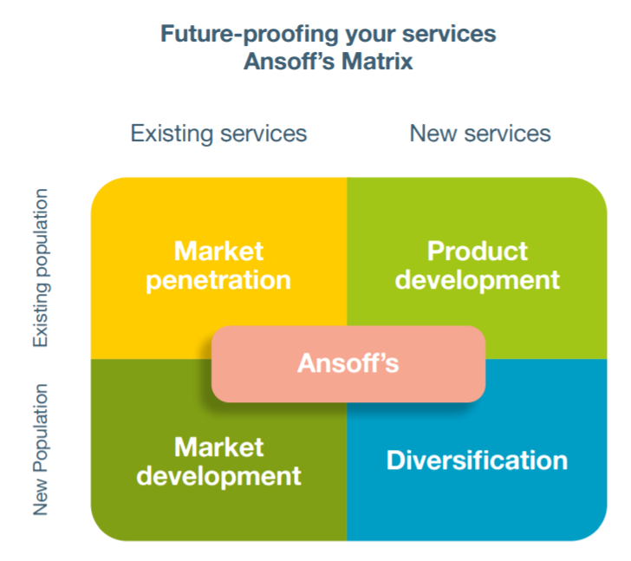
GM Workforce Planning Workshop
Domain: Demand

Slide 22

DOMAIN: WORKFORCE DESIGN
GM Workforce Planning Workshop

Slide 23

GM Workforce Planning Workshop
Domain: Design
D
mapping
Skills | knowledge | competencies
“Listing” knowledge and skills/mapping knowledge and skills onto pathways/scenarios
Deciding on levels of competence; challenges
Considering the “shape” of workforce

Slide 24
GM Workforce Planning Workshop
Domain: Design

Slide 25
GM Workforce Planning Workshop
Domain: Design
E
Roles | Job Design | Volume

Slide 26

Domain: supply
GM Workforce Planning Workshop

Slide 27

GM Workforce Planning Workshop
Domain: SUPPLY
Supply data
F
Labour market
Current workforce
Pipelines

Slide 28

DOMAIN:
MAKE IT HAPPEN
GM Workforce Planning Workshop

Slide 29
GM Workforce Planning Workshop
Domain: MAKE IT HAPPEN
Defining
implementation plan | priorities
G

Slide 30


GM Workforce Planning Workshop
Domain: MAKE IT HAPPEN
YOUR ROLE
Of Locality Workforce Planning Facilitator
Expectations
Change Agent
Coach and Buddy

Slide 31

GM Workforce Planning Workshop
Domain: MAKE IT HAPPEN
What’s next?
Action planning for your locality
Future planning
Call to action
Further support

Slide 32
GM Workforce Planning Workshop
Thank you
For queries, please contact:
Hannah Thornton
Programme Manager: One Workforce, One Model
hannahthornton@nhs.net

